Slide 1
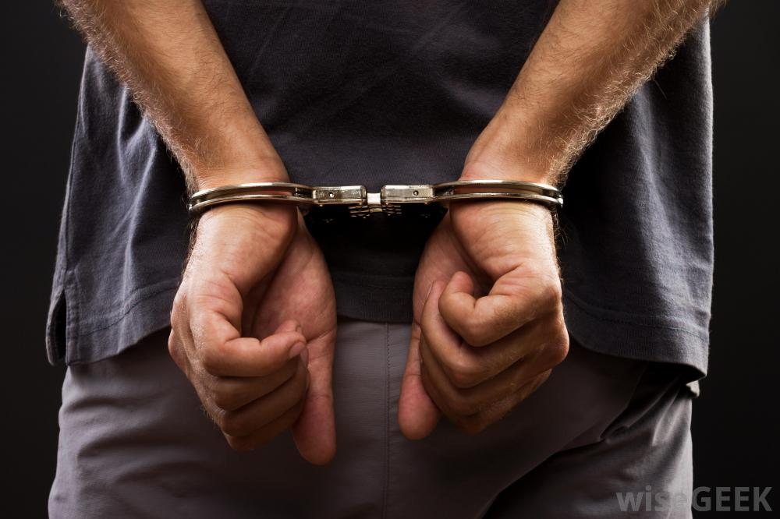
Mircea ZLOTEANU
Looking Guilty:
Handcuffing suspects influences judgements of deception
GUILTY?
INNOCENT?

Slide 2
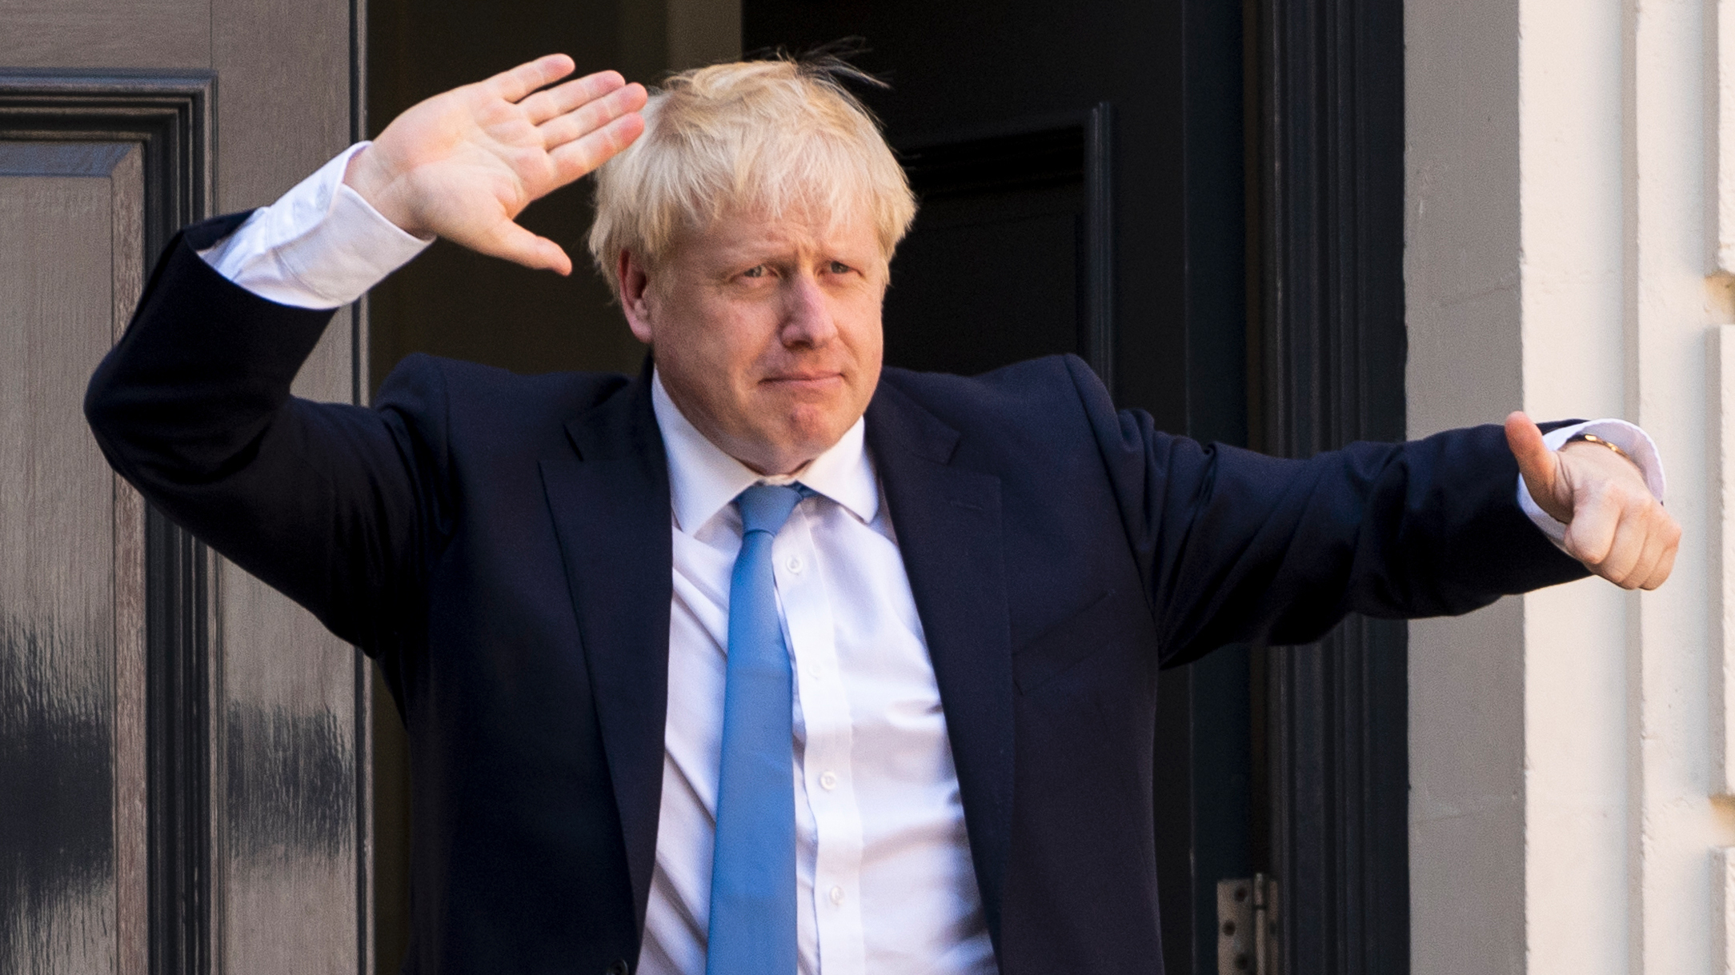
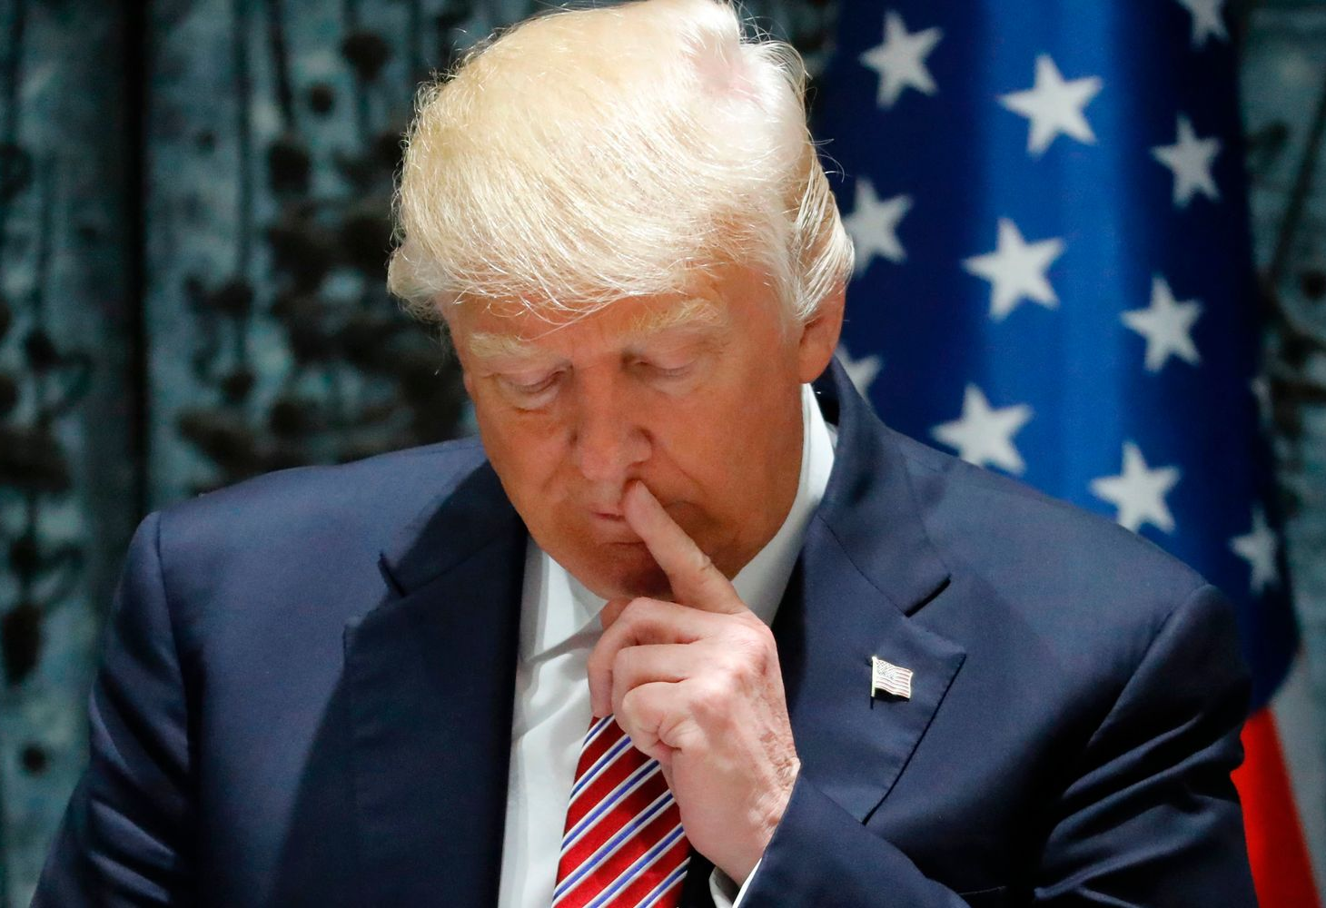
Detecting Lies and Truths
People lie often and for various reasons
However, detection rates are ~54%
Bias towards believing others are honest
No one definitive cue of lying
Meta-analyses find (inconsistent) clusters of “cues”

Slide 3
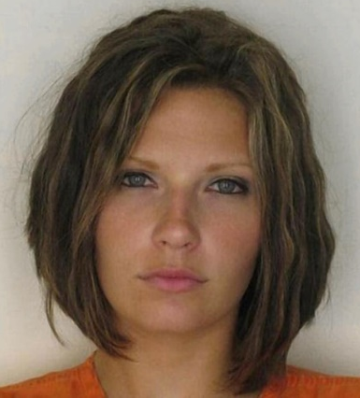
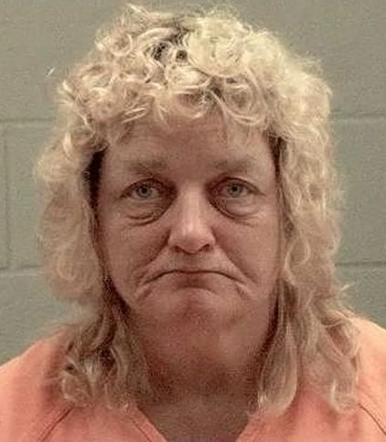
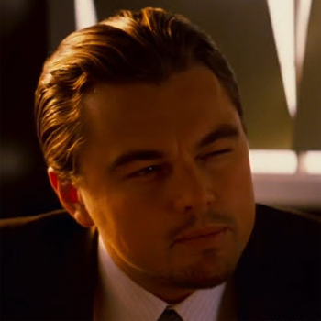
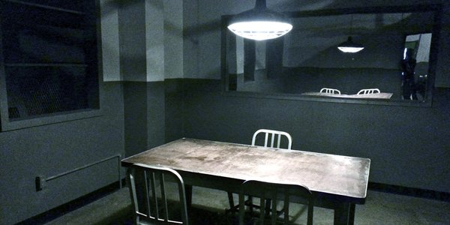
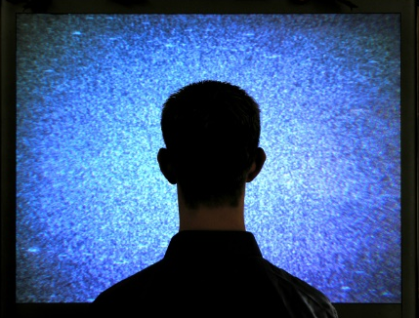
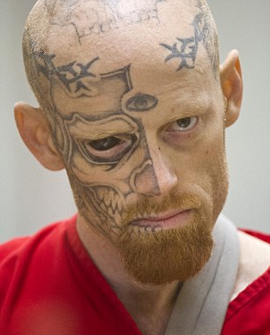
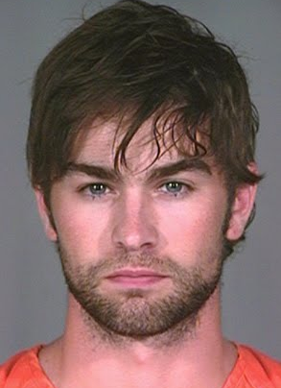
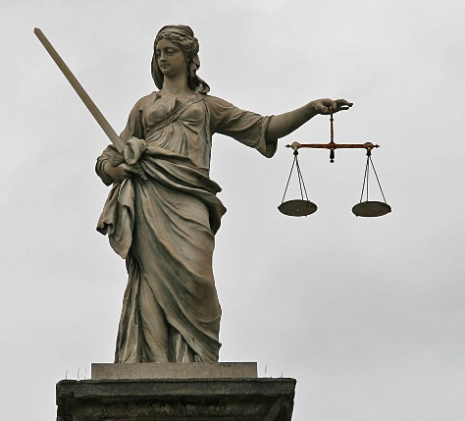
THEORY
SUSPECT
SITUATION
JUDGE
CIRCUMSTANTIAL
Factors that are not due to either individual differences or experience/instructions.
How does the setting affect veracity decisions?
Suspiciousness
(Levine & McCornack,1991)
PERMANENT
EXPECTATIONS
Attractiveness = more lenient
(Sigall & Ostrove, 1975)
Priming
(Levine, Serota & Shulman, 2010)
False Alarm
vs
Miss
Face tattoo = appear guilty
(Schulz-Hardt & Kohnken, 2000)
(Funk & Todorov, 2013)

Slide 4
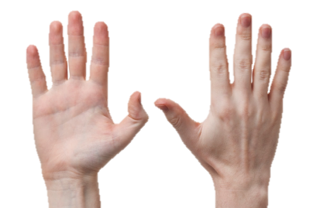
PRESENT STUDY
REASONING
Liars show reduced movement
Restricting motion makes it harder to present yourself
PREDICTIONS
H1 Handcuffing people will make discriminating liar and truth tellers more difficult (lower accuracy)
H2 Handcuffs bias perception of the suspect (reduced truth-bias)
H3 Suspiciousness will differ between police and laypersons
H4 Police Officers will be more confident
AIM: Do handcuffs affect veracity judgements?
Notes:
Harder to detect veracity
(biasing effect)
Police are less biased due to experience with interrogations
Meissner and Kassin (2002) – experience increases bias
Garrido et al.'s comparison (2004) – no difference in bias between students and police officers

Slide 5
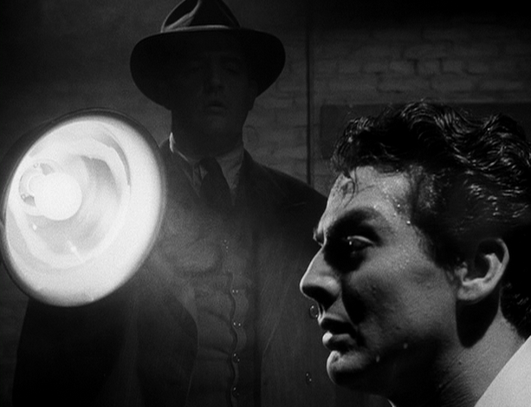
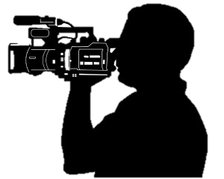
PART 1
VIDEO CREATION

Slide 6
Method
SUSPECTS
Participants
-suspects
N = 19 “suspects”
-interrogator
One interrogator (35 y, male); Police Officer, trained in interrogations.
Design
2 x 2 mixed
between: Restraint (Handcuffs vs. No-Handcuffs)
within: Veracity (Lie or Truth)
VS

Slide 7
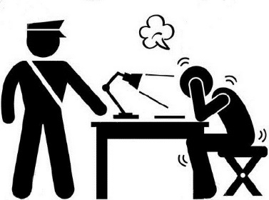
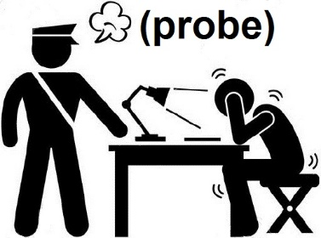
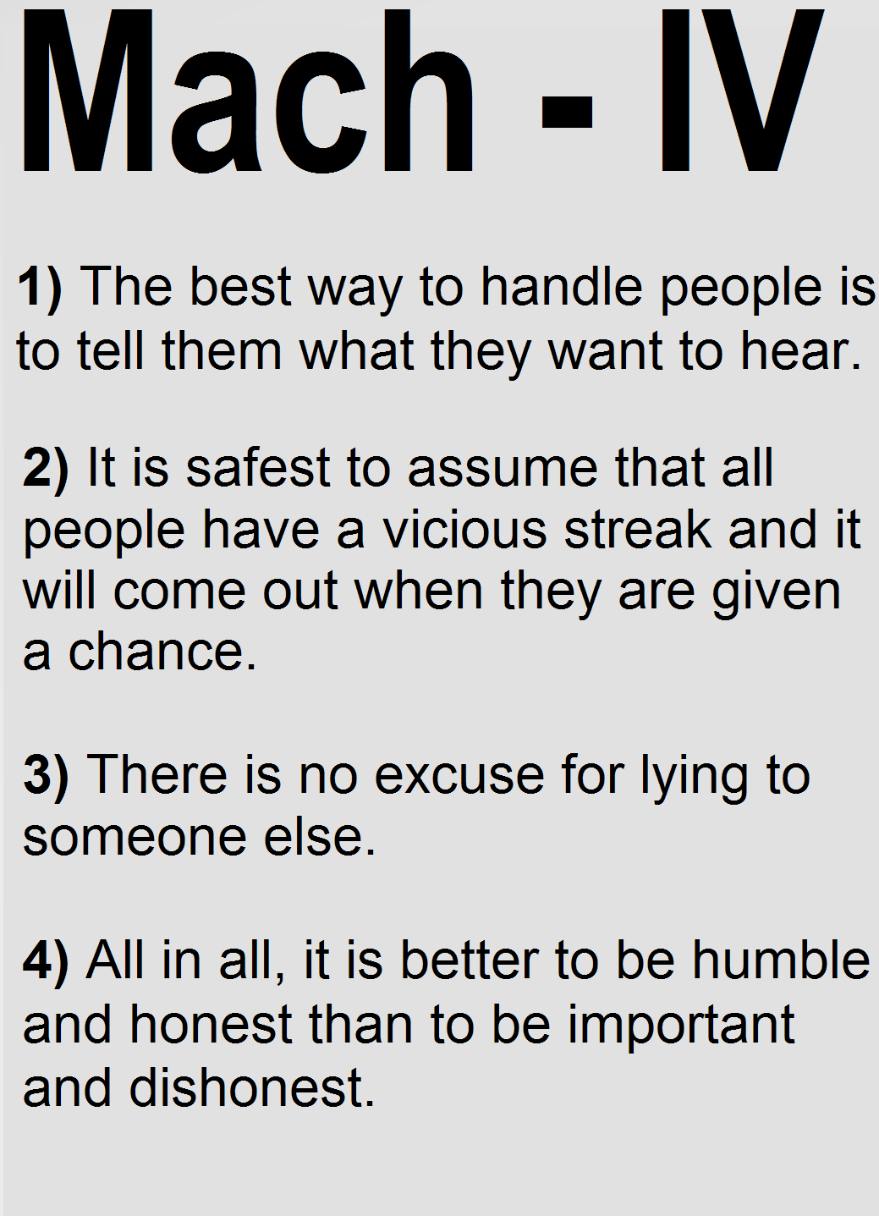
Method
ACTORS
Procedure
4 question Mach. questionnaire (2 lies, 2 truths)
Q1. “The best way to handle people is to tell them what they want to hear”
2 answers were randomly altered
The new answers where given to the interrogator
The interrogator probed (positive/neutral/negative) the “suspects”
Half of the suspects were interrogated while being handcuffed.
MODIFIED
RECORDED
Real
Half Alt.
Initial
Pos/Neutral/Neg
Final

Slide 8
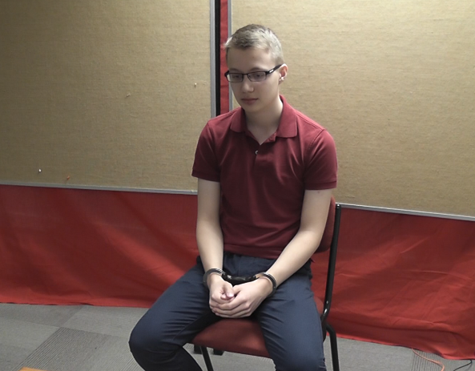
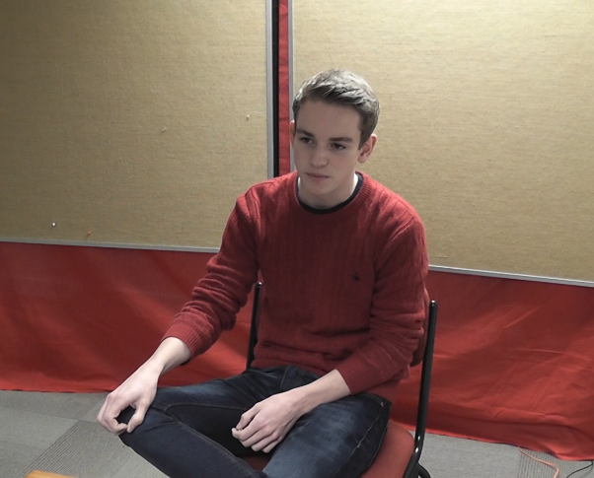
Method
SUSPECTS
Stimuli Creation
16 videos were created
8 (4 lies, 4 truths) with Suspects in Handcuffs and No-Handcuffs
VS
“Suspect” in the Handcuffs condition
“Suspect” in the No-Handcuffs condition

Slide 9
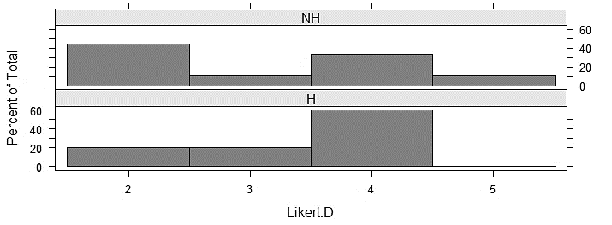
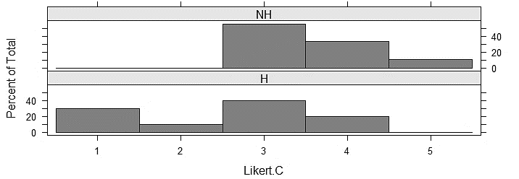
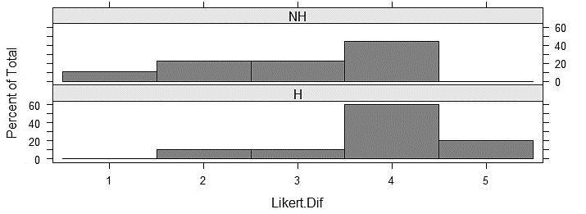
Results
SUSPECTS SELF-RATINGS
Did Handcuffed suspects feel differently than Non-handcuffed suspects?
Discomfort: Handcuffed suspects felt more discomfort (small effect; Δ = 0.16)
Confidence: Handcuffed suspects felt less convincing (moderate effect; Δ = -0.49)
Task difficulty: Handcuffed suspects felt the Lying Task was more difficult (moderate effect; Δ = 0.47)
Notes:
*cognitive load?

Slide 10
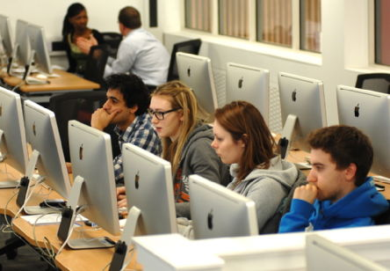
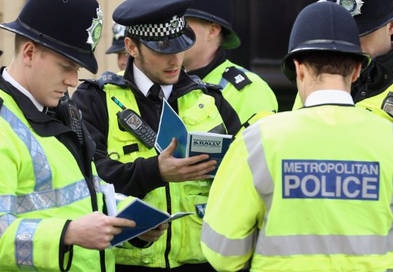
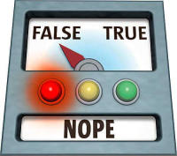
PART 2
TESTING
LAY PERSONS
POLICE OFFICERS

Slide 11
Method
LAY PERSONS
&
POLICE OFFICERS
Participants
-lay persons
N = 83 (36m, 47f), M_{age} = 24
-police officers
N = 23 (17m, 6f), M_{age} = 31
Design
2 x 2 x 2 mixed
between: Restraint (Handcuffs vs. No-Handcuffs) AND Judge (Police Officer or Lay Person)
within: Veracity (Truth or Lie)
DV: Honesty, Confidence, Bias

Slide 12
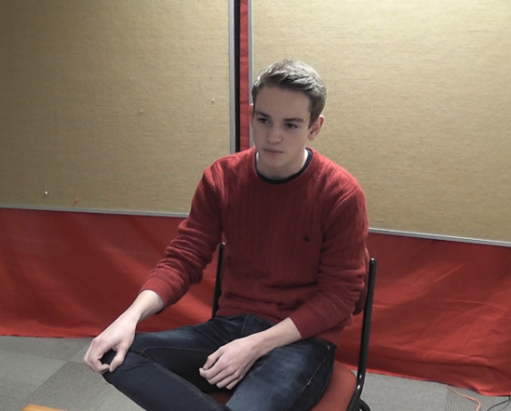
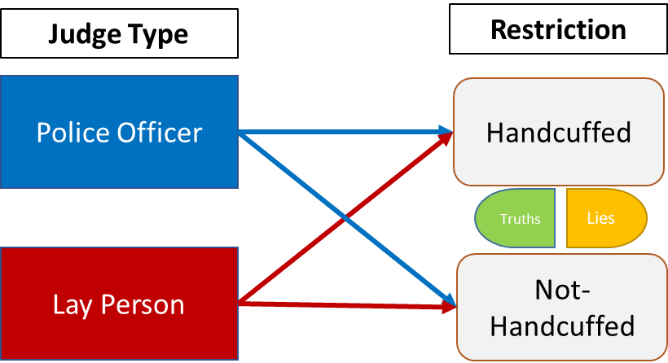
Method
LAY PERSONS
&
POLICE OFFICERS
Procedure
Each participant saw one condition only
Made veracity judgements of the suspects on a 5-point scale (Very Dishonest – Very Honest)
Rated their confidence in these judgments on a 7-point scale
Notes:
[Handcuffed suspects (Obs.=43, Police=12); Non-handcuffed suspects (Obs.=41, Police=11) ]

Slide 13
Results
INTERROGATOR
Accuracy: trend towards truths and lies being harder to detect when the suspects wore handcuffs. But the effect was not statistically significant
+ 0 |
Confidence: No difference bw conditions
Bias: No difference. Both truth-biased
Probes: No significant difference in usage

Slide 14
Results
JUDGES
Veracity: Lies (44%) were harder to detect than truths (53%)
Accuracy: lower for handcuffed (44%) than non-handcuffed (51%)
Judge: no difference in accuracy between police officers (45%) and laypersons (49%) *[trend]
Confidence: police officers were more confident in their judgements than laypersons
Bias: No difference in bias; overall truth-biased
Notes:
Handcuffs had an effect. Harder to spot lies. Observers also thought more people were truthful.

Slide 15
Conclusion
Interrogator
Handcuffs made veracity judgements more difficult (trend only)
Handcuffs did not affect the overt (probes) or covert (bias) level of suspiciousness.
Lay Persons & Police officers
Worse at detecting lies and truths when suspects wore handcuffs.
Overall truth-biased for both conditions
Police Officers were overconfident in their decisions
Handcuffing effect overall
NNT = 5. For every fifth handcuffed person interviewed we expect one more veracity misclassification
Probability that a suspect selected at random from the handcuffed condition is misclassified is 64.3%.

Slide 16
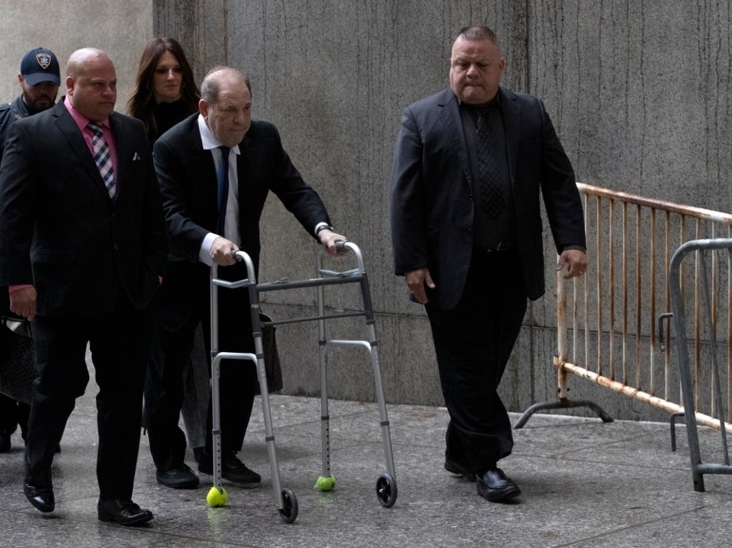
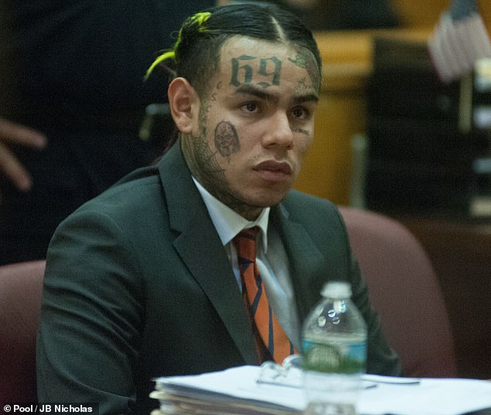
IMPLICATIONS
Situations Factors
Procedural elements or circumstance can impact perception and judgements
Attention must be paid to how these can bias the CJS and outcomes
Interactive effects must be considered (e.g., third party perceptions [juries])

Slide 17
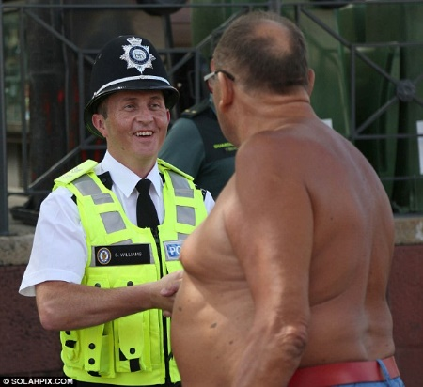
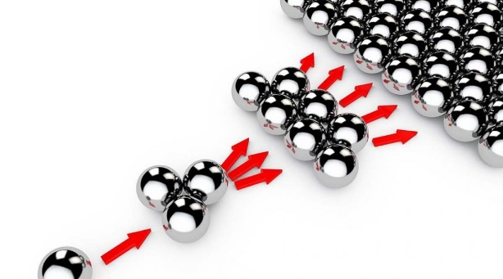
Limitations & considerations
Sample size
Small and unbalanced, police officers (n = 23) and laypersons (n = 83)
Uncertain and imprecise effect estimates, ξ = .33 [.11, .56] (small to moderate)
More collaboration needed
Difficult to conduct such studies without cooperation and partnership
Need to incorporate practical needs (police) with scientific requirements (researchers)
Replication and extensions
A single study is not very useful for drawing conclusions
Important findings must be replicated and generalised

Slide 18
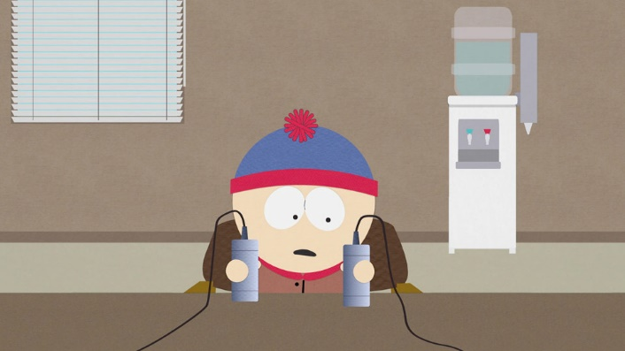
Future research
Separate the perception of the suspect to their actual ability to gesticulate as the source of the effects.
a). Eliminate the effect of movement – hands are grasping an object on the table
b). Eliminate the “suspects” impression management effect - edit the videos so that the hands can either have cuffs on them or not
Hands Fixed + No-Handcuffs
Hands Fixed + Handcuffs

Slide 19
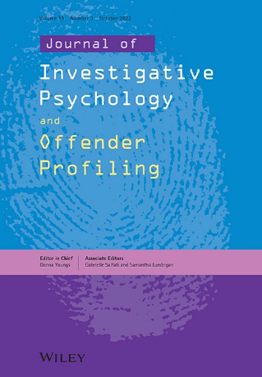
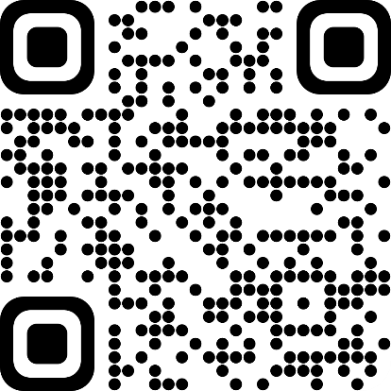
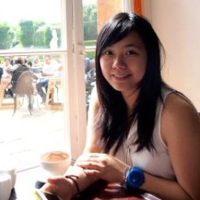
Thank you! Questions?
Nadine Salman
Andrea Yeung
Notes:
Thank you for your time – and I look forward to your questions

