Slide 1
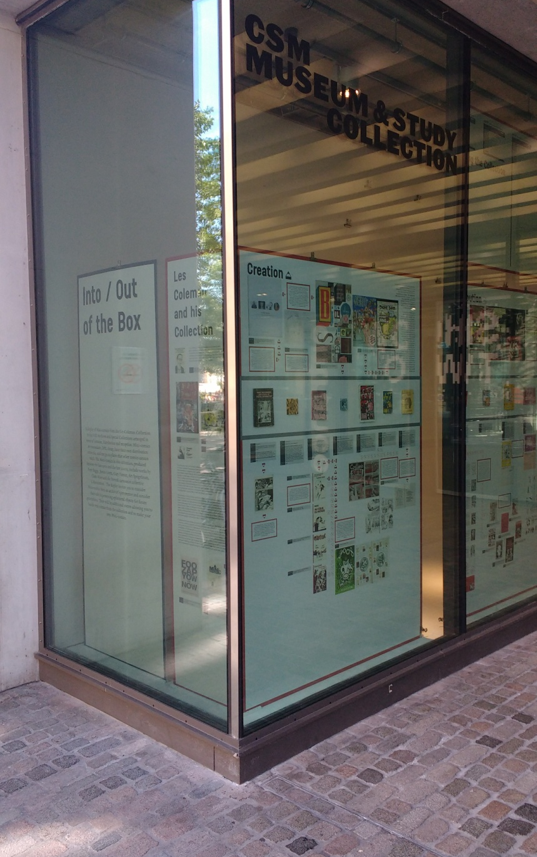
Issues of Inclusion when Archiving and Displaying Mini-Comics from the Les Coleman Collection
Ian Horton
London College of Communication,
University of the Arts London
John Miers
Kingston School of Art

Slide 2
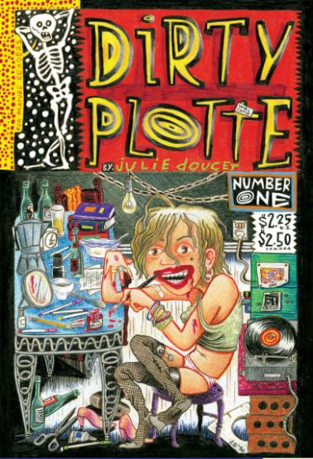

Slide 3
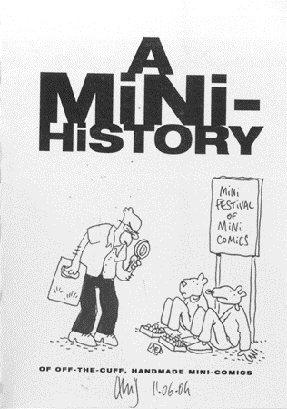
Comics have long been remained out of the purview of archivists, librarians, and other institutional safeguards of cultural memory. Situated at the lower end of the economies of cultural memory, comics have often ended up in the waste bins of cultural mass production than in the closely monitored storage of archive.
M. Ahmed and B. Crucifix (2018) Comics Memory: Archives and Styles.
...the moveable and indeed unfixable borderline between value and worthlessness, between cultural waste and the cultural archive, is the effect of continuous decisions and negotiations.
Assmann (2011) Cultural Memory and Western Civilization: Functions, Media, Archives

Slide 4
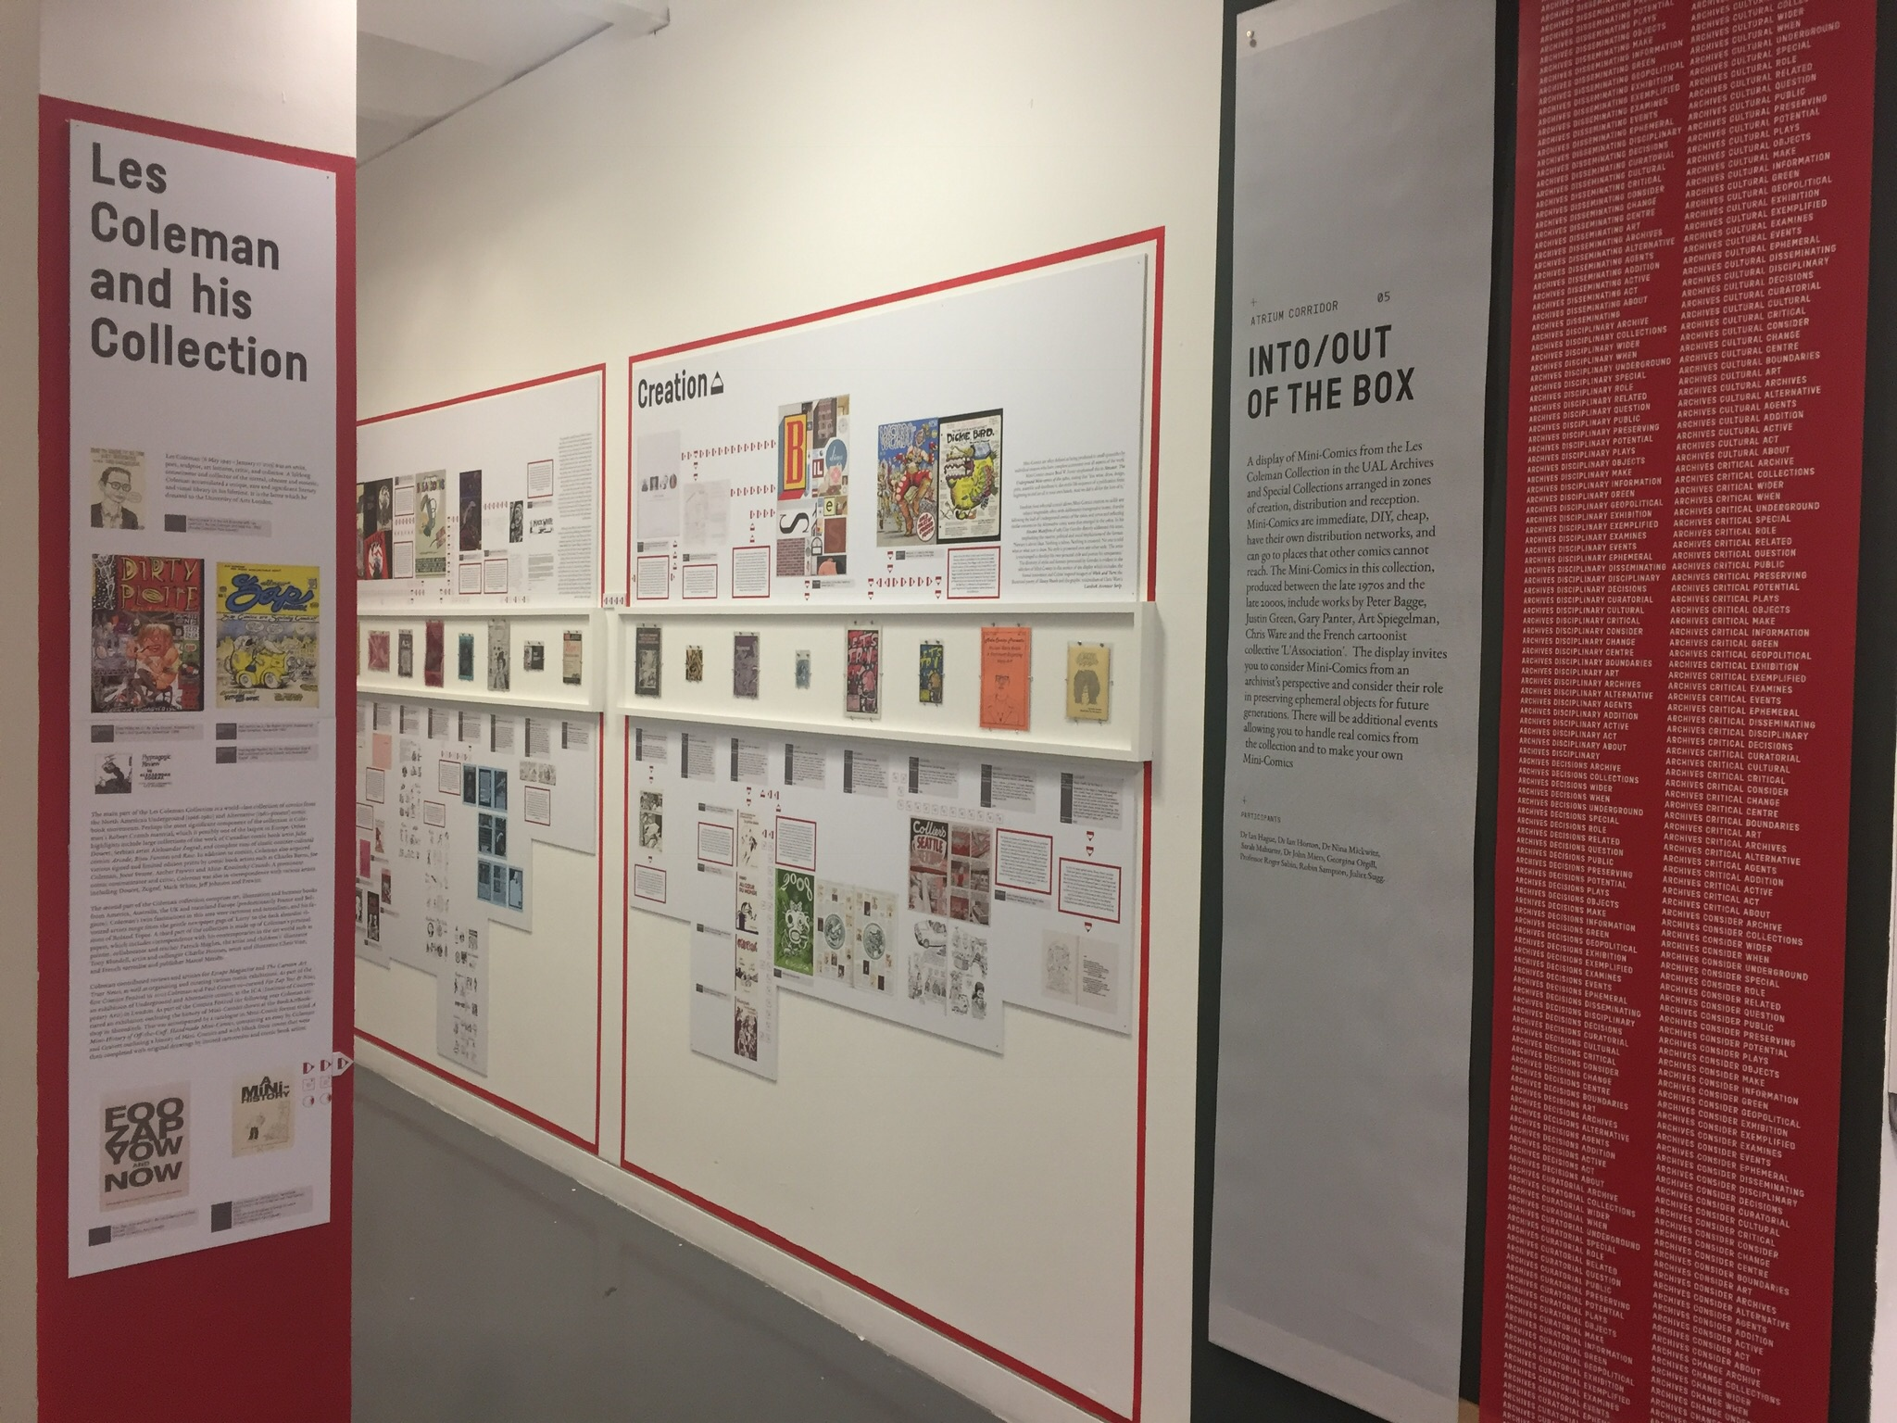

Slide 5
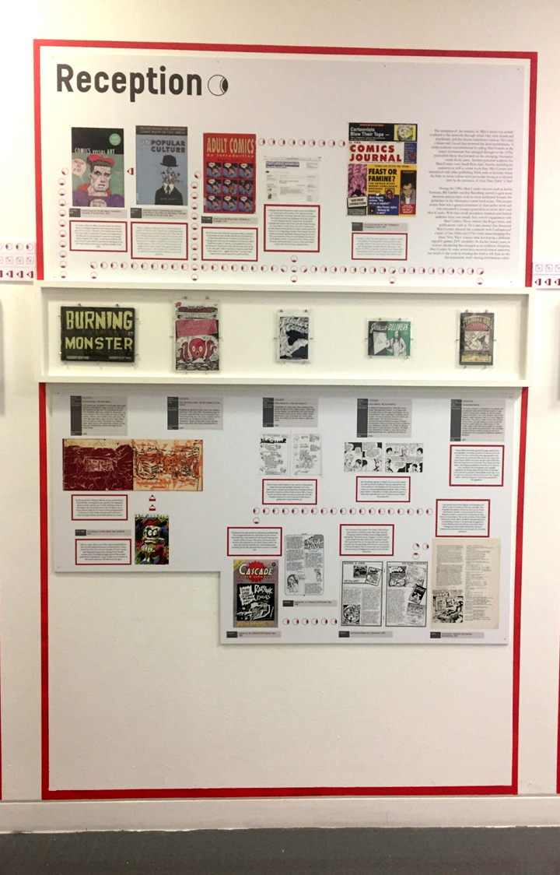
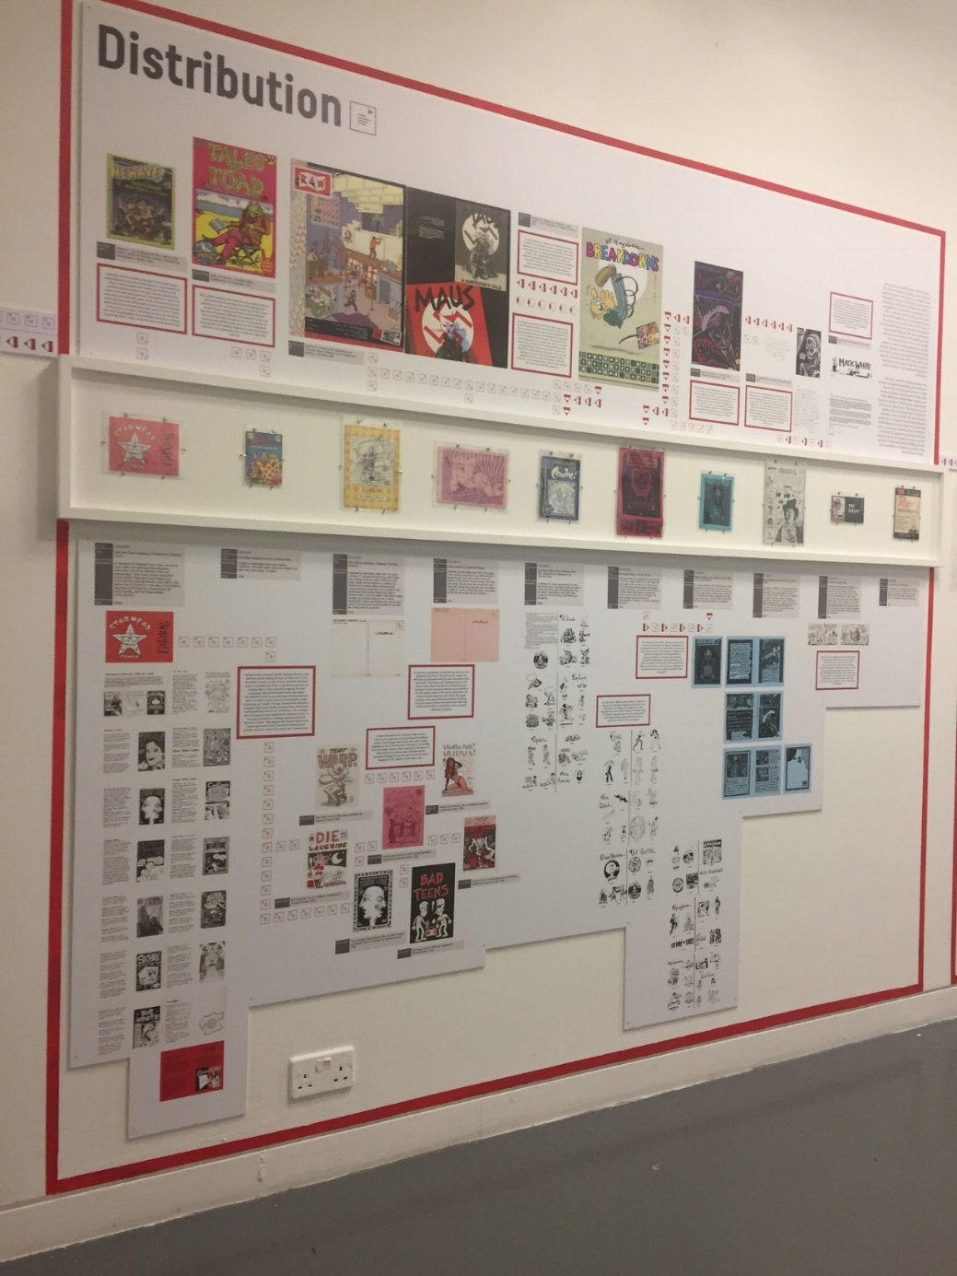

Slide 6
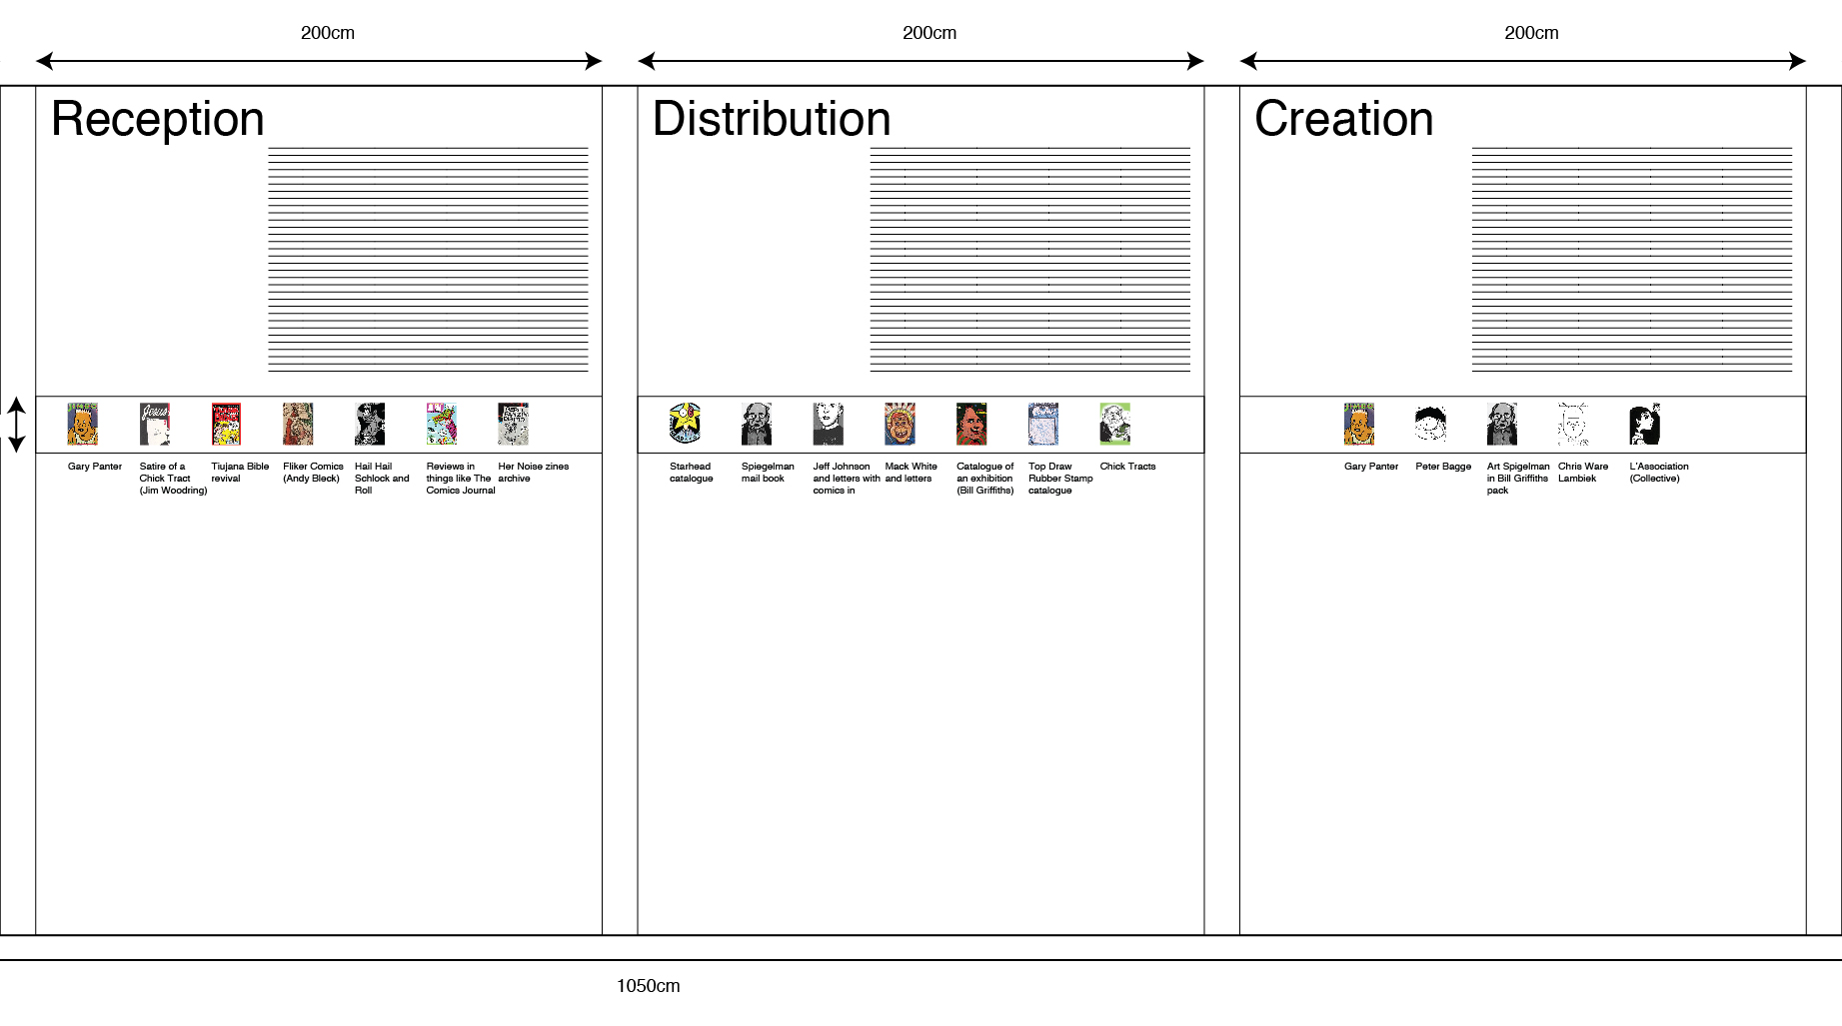
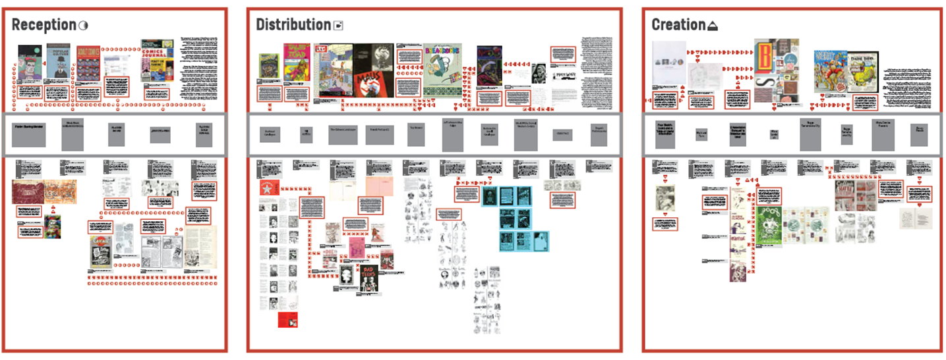

Slide 7
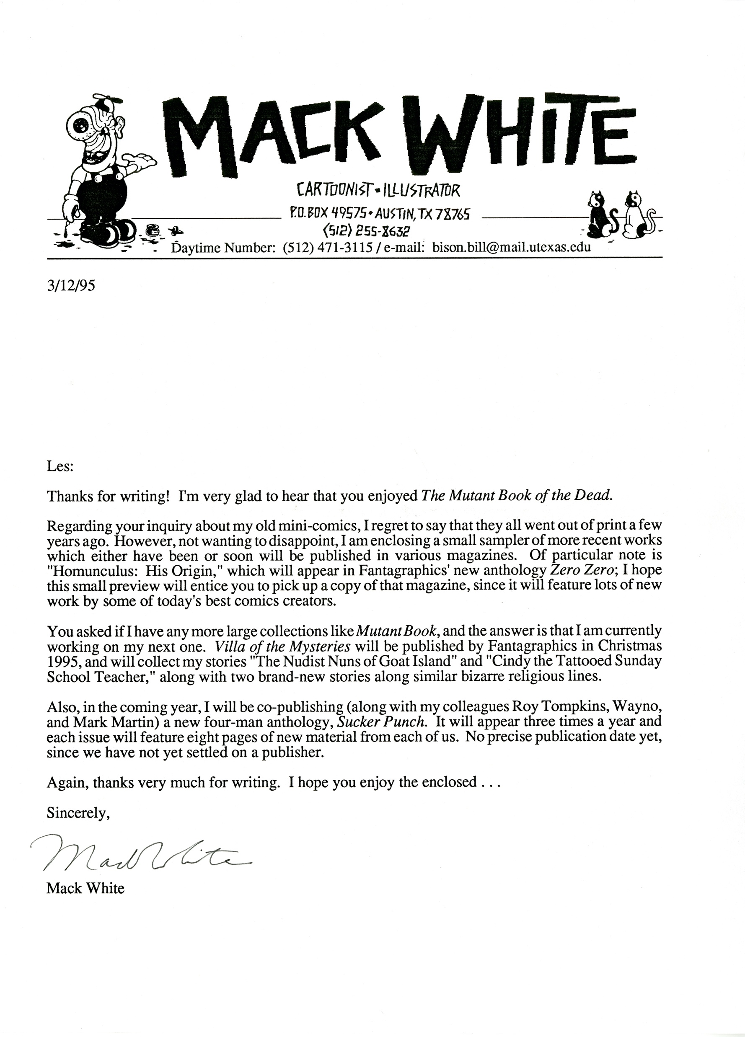

Slide 8
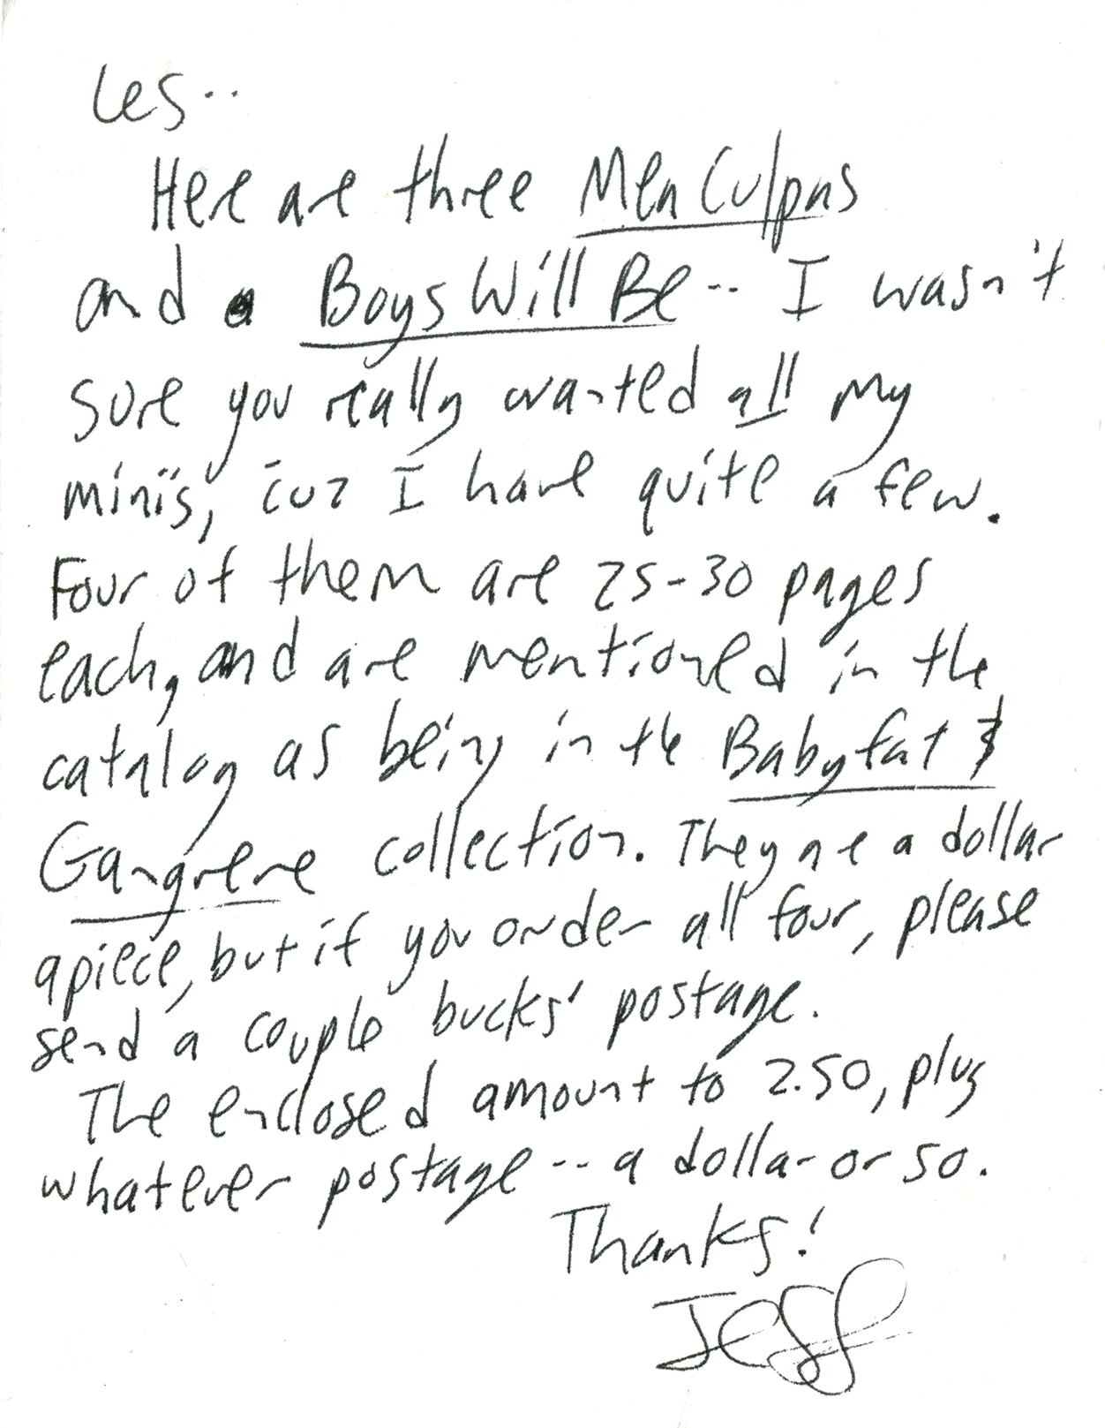

Slide 9
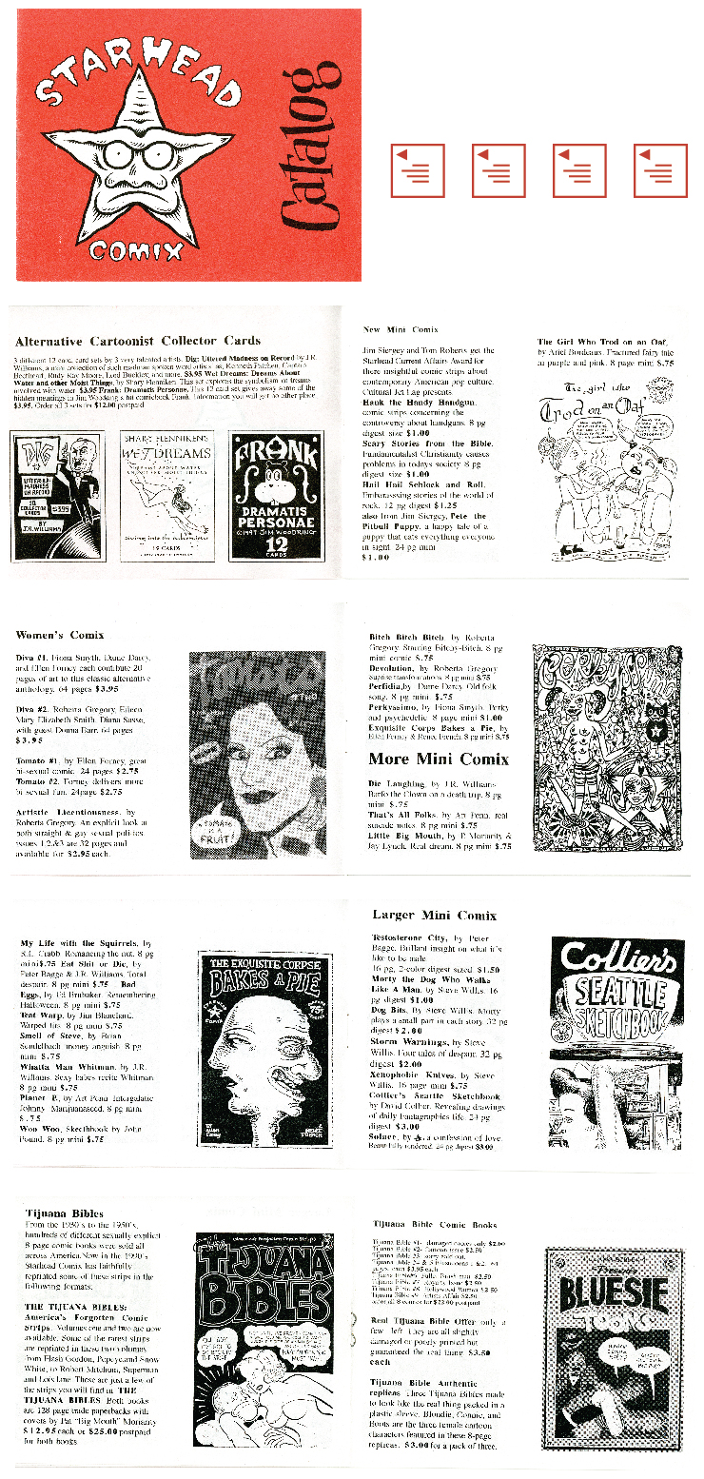
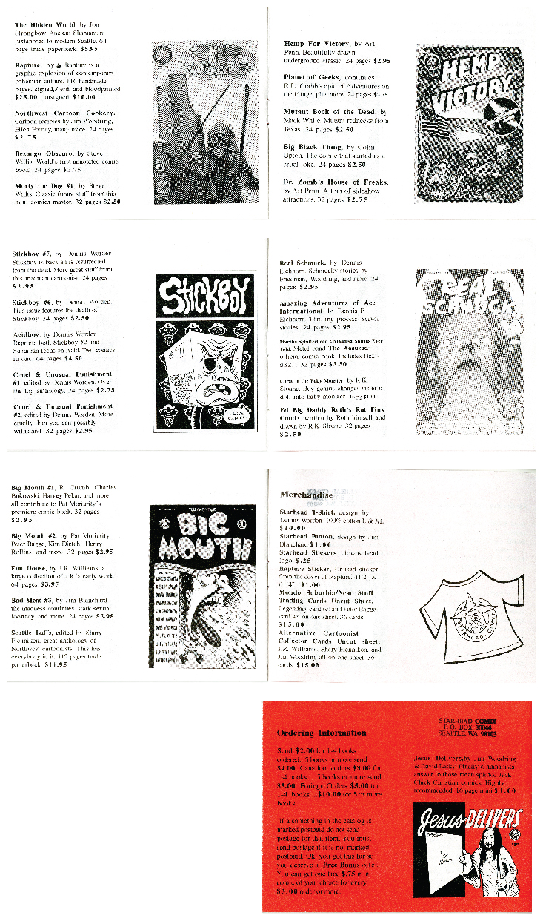

Slide 10
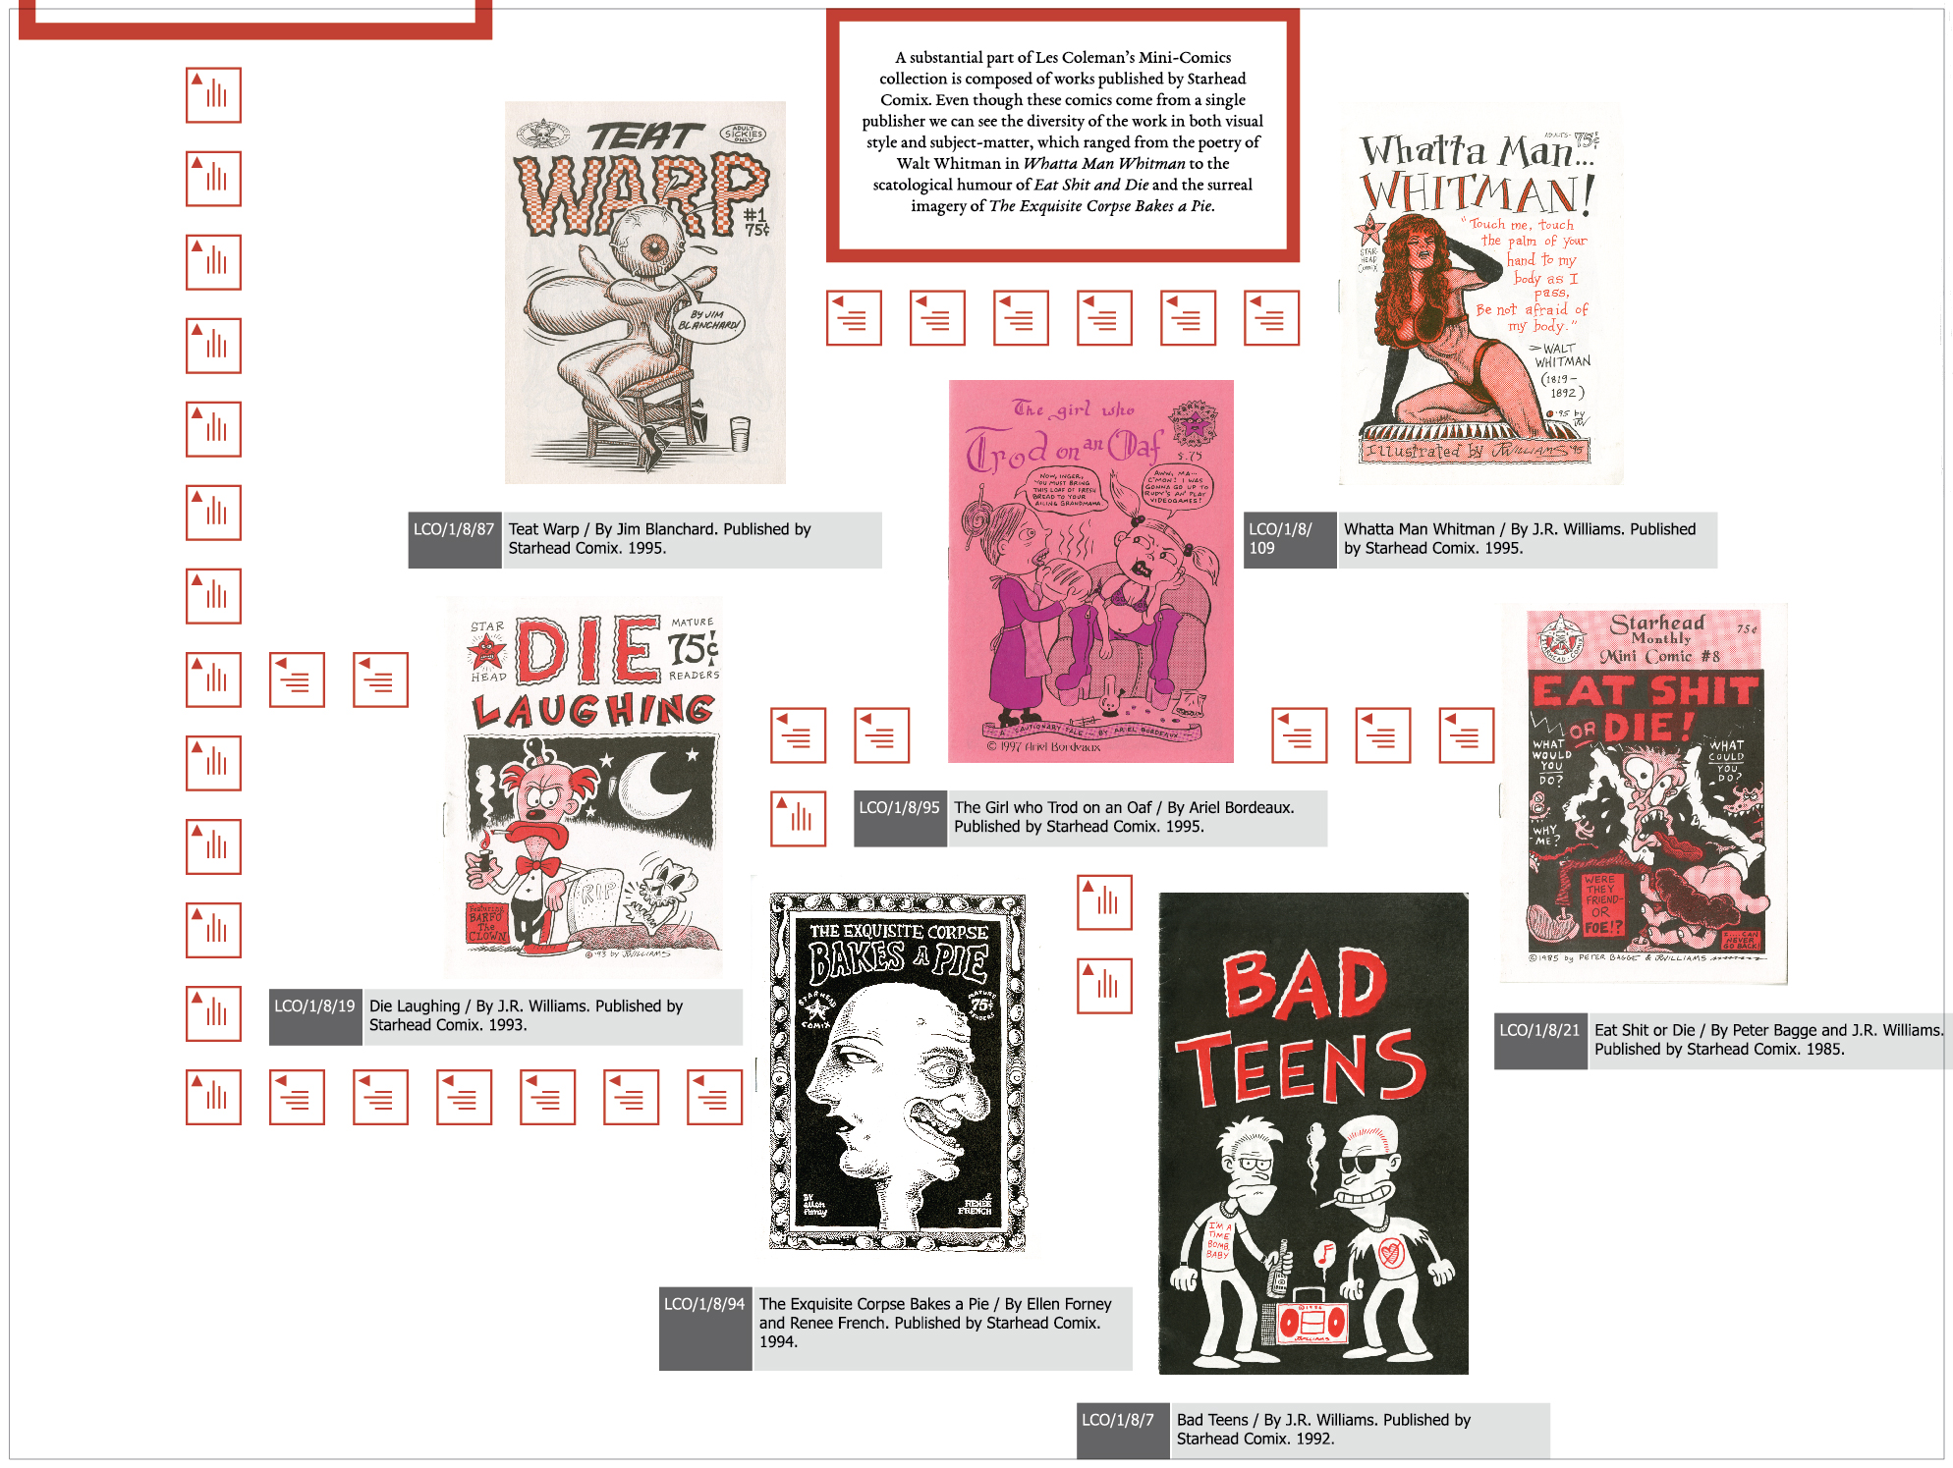

Slide 11
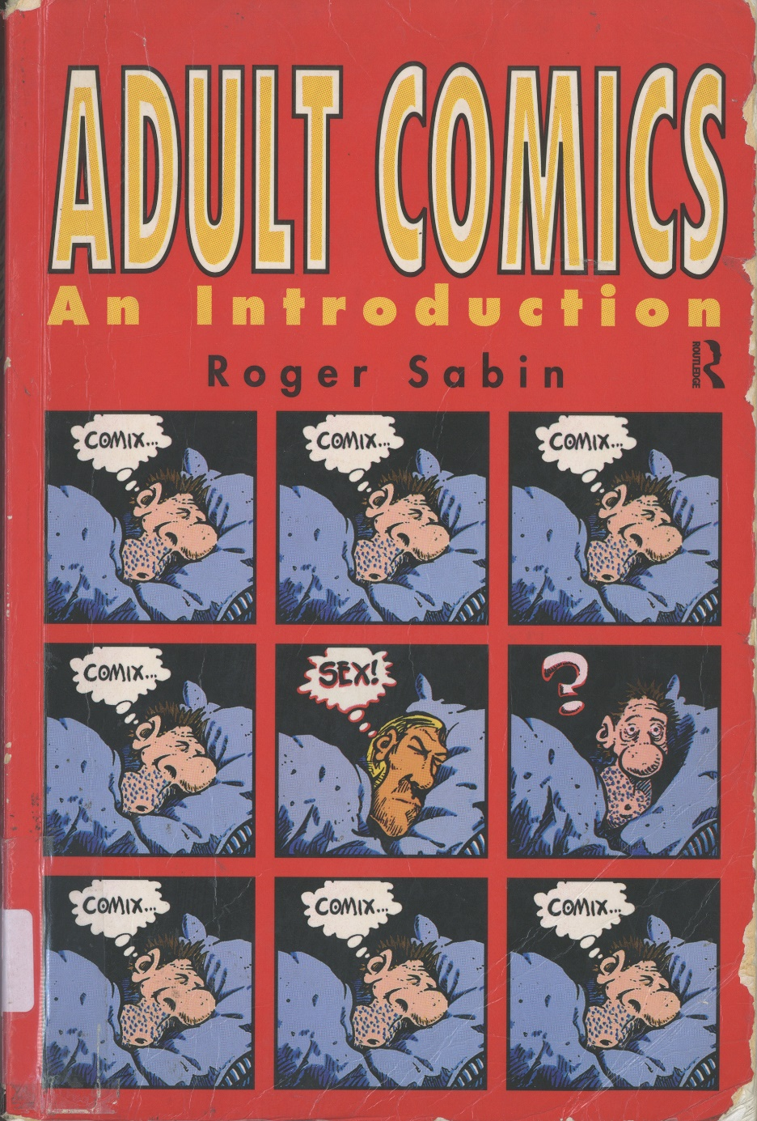
Sabin’s book is one of the first academic studies to examine the potential of comic books, both British and American, to deal with adult themes. It explores the influence of Underground comics on the emergence of what were called Small Press comics in Britain, as exemplified by comics distributed by Paul Gravett’s Fast Fiction mail order service in the early 1980s. Sabin notes that in America such Small Press comics were ‘...tagged ‘New Wave’’ and that these creators were clearly inspired by a punk aesthetic.

Slide 14
Key Issues
The exhibition highlighted underground distribution networks such as Starhead Comics, while the presence of familiar names including Art Spiegelman, Gary Panter and David B. indicated the role self-publishing networks can play in hierarchization and legitimisation.
Catalogues held in the collection alerted us to the existence of a range of competing terms for describing the products and practices of self-publishing cartoonists, reminding us of the role of definitions and terminology in deciding what is in and outside any corpus, and the relative lack of attention this particular definitional question has received in comics studies.
The inclusion of such publications, alongside books of postcards, sketchbook drawings and rubber stamp designs also raised the question of what types of object count as Mini-Comics.
Browse the Les Coleman collection: bit.ly/minicomix

Slide 16
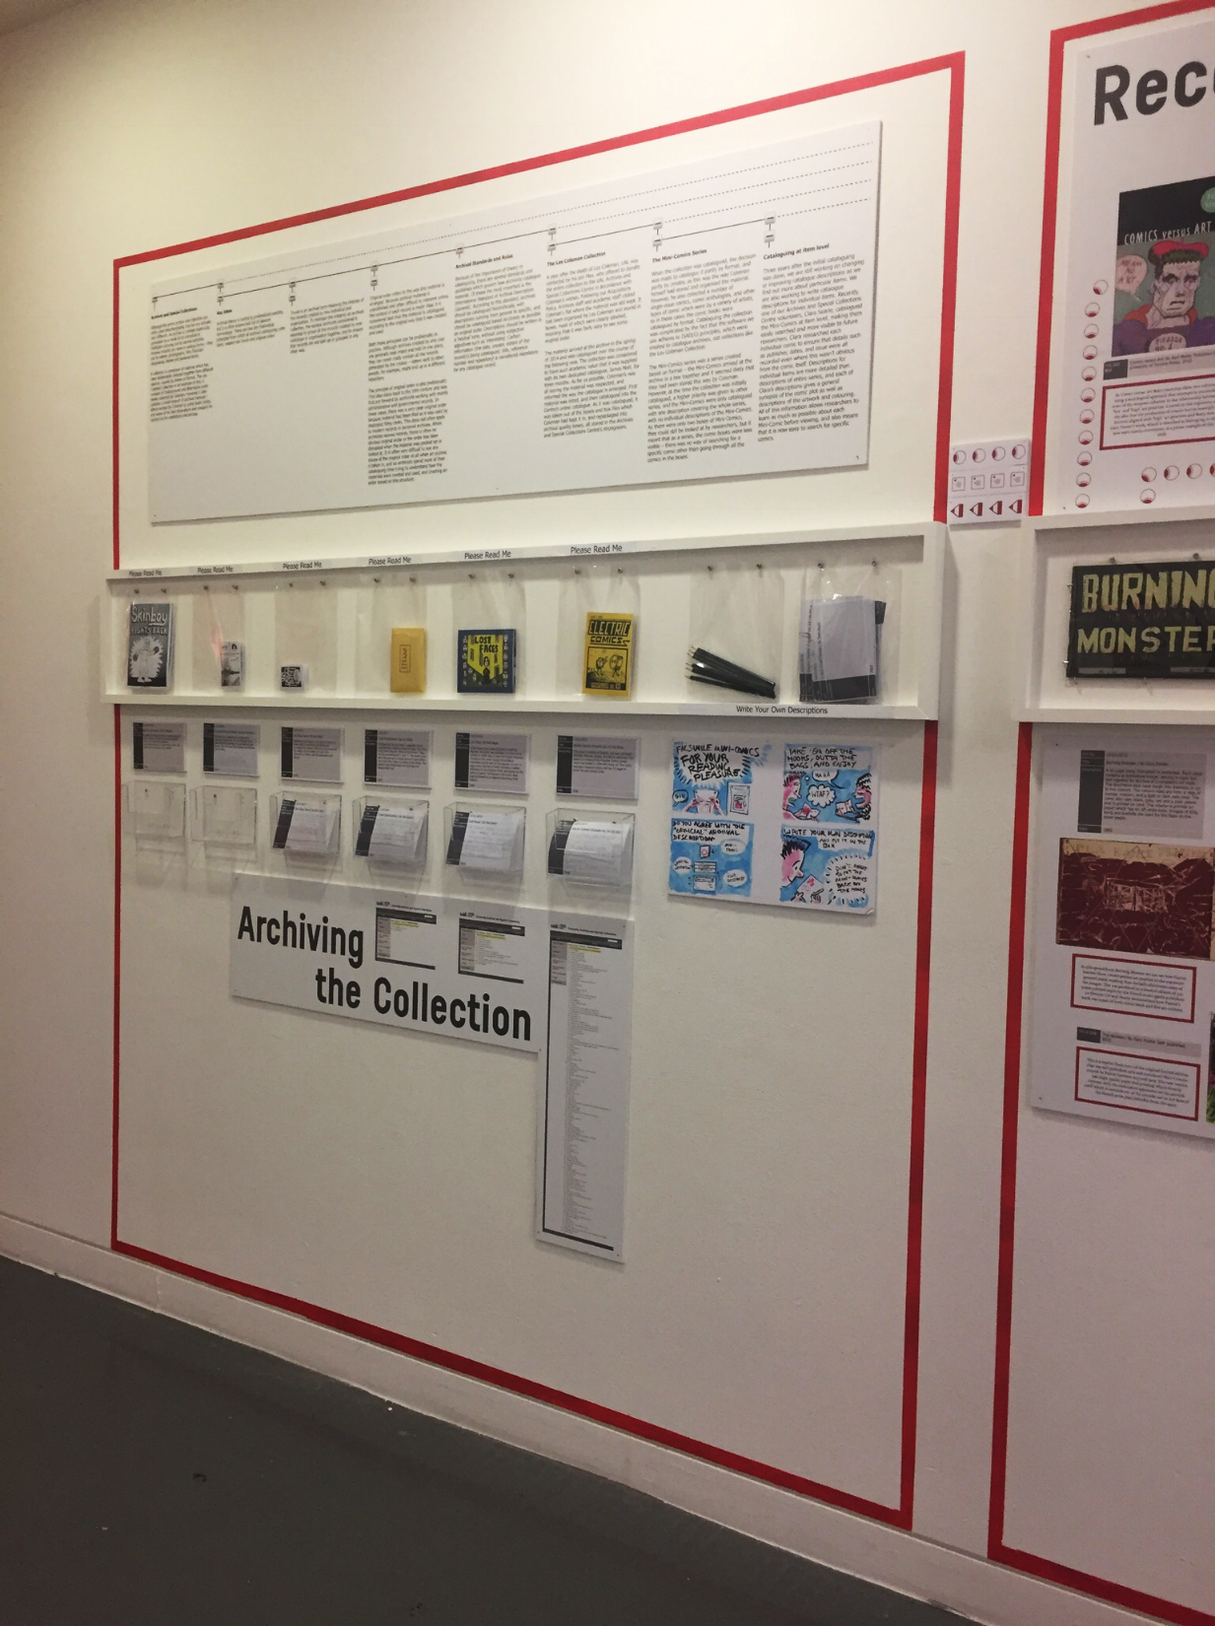

Slide 17
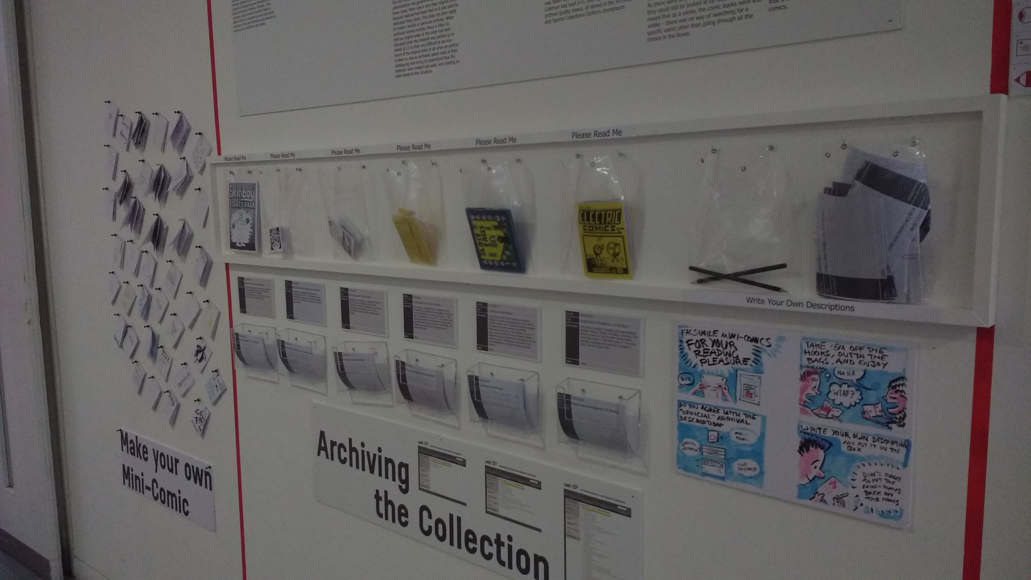

Slide 18
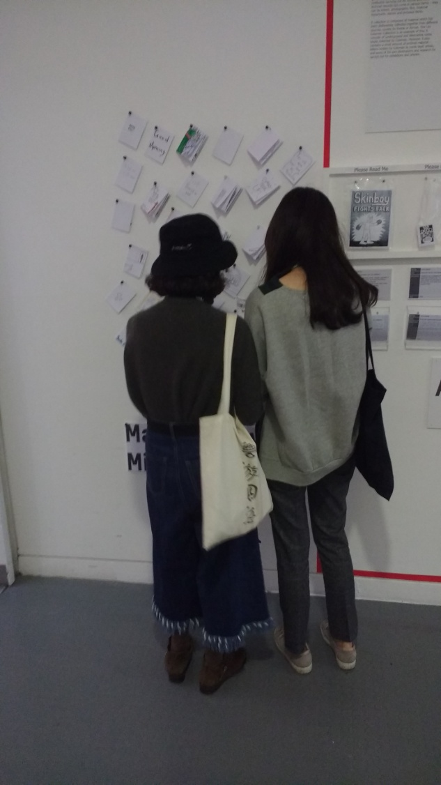
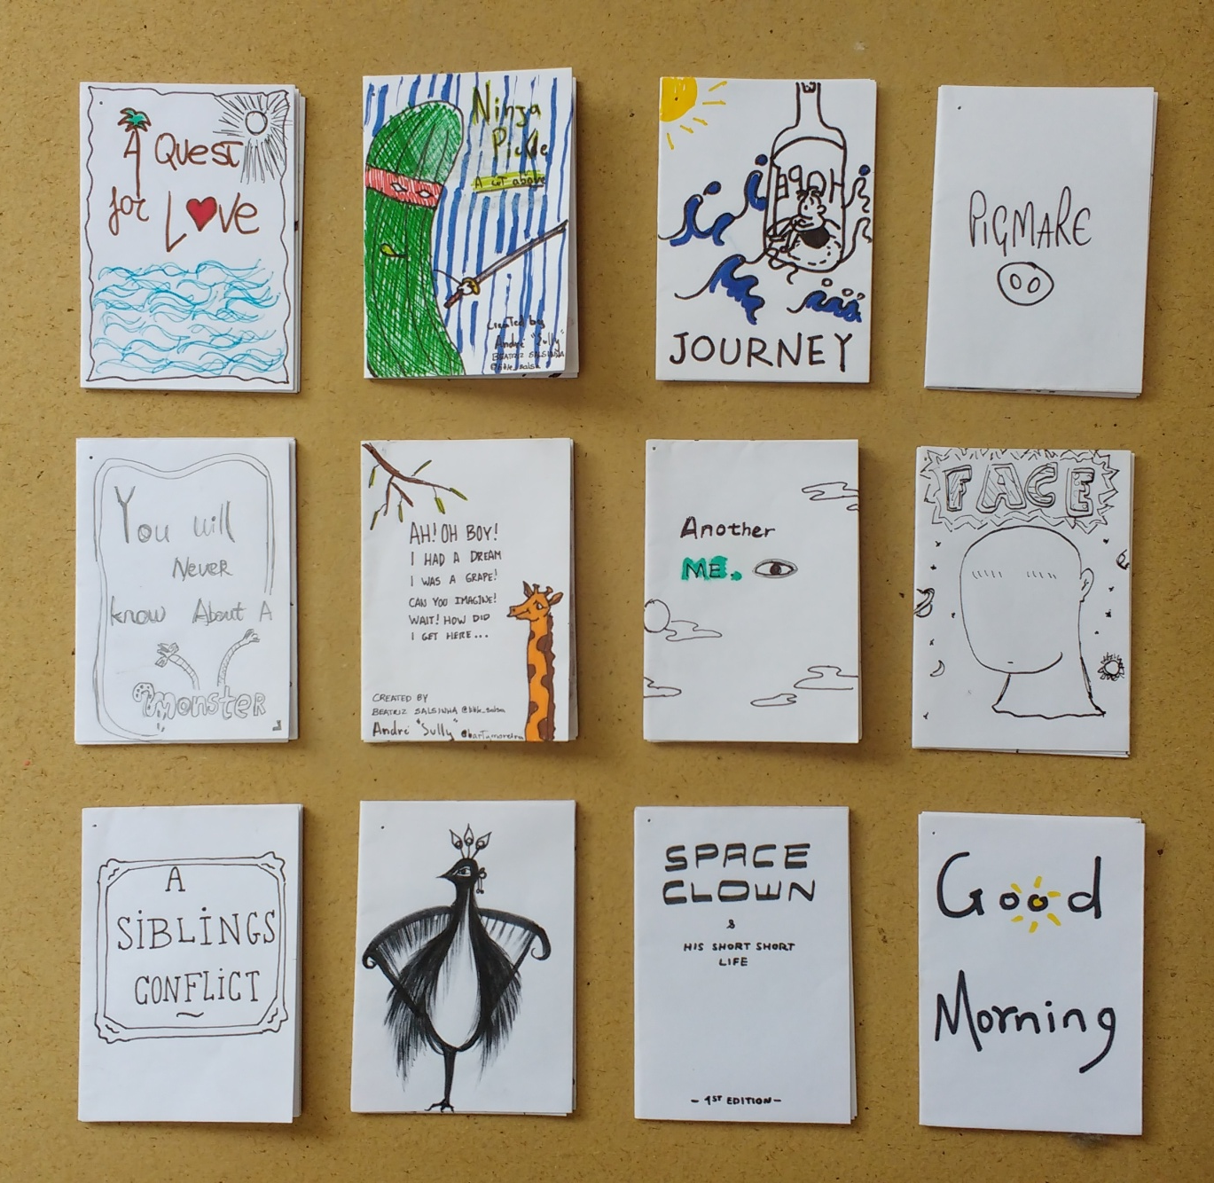

Slide 19
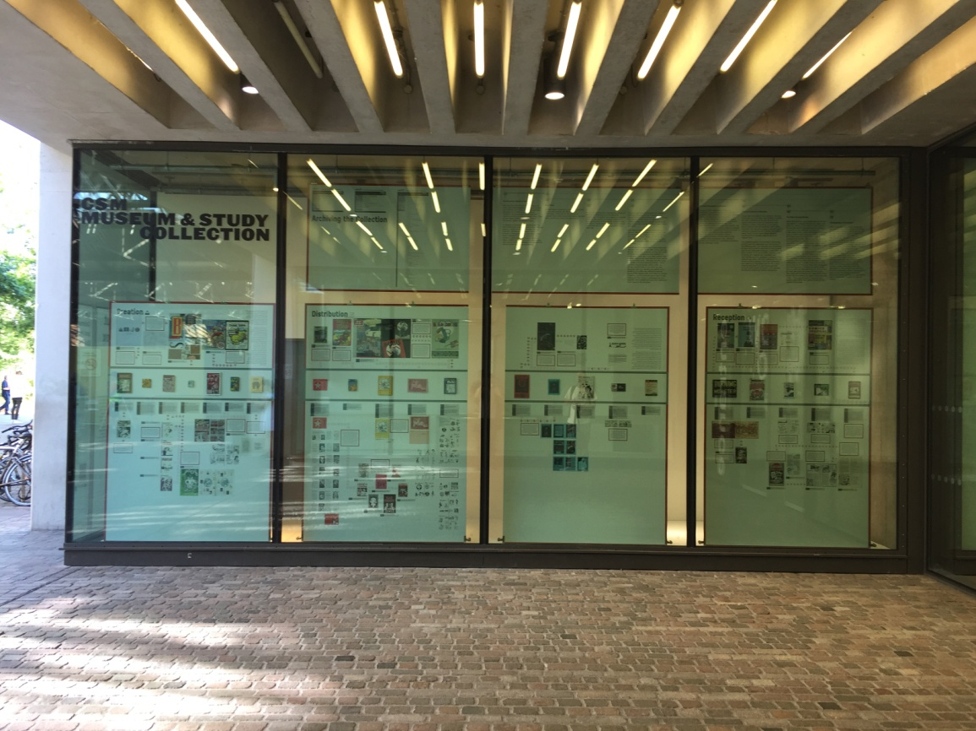

Slide 20
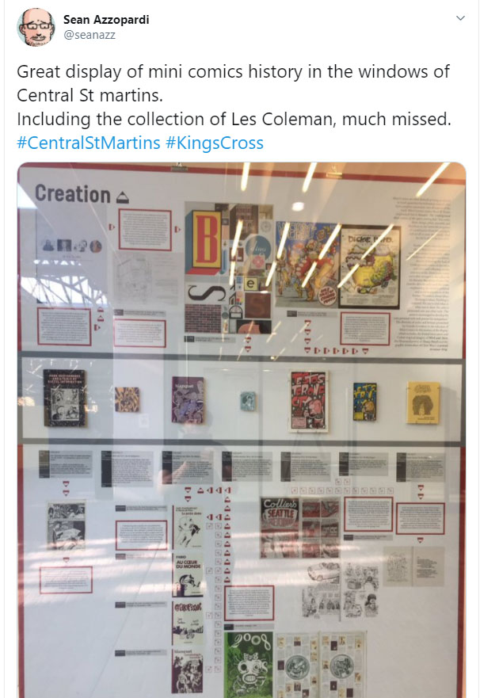
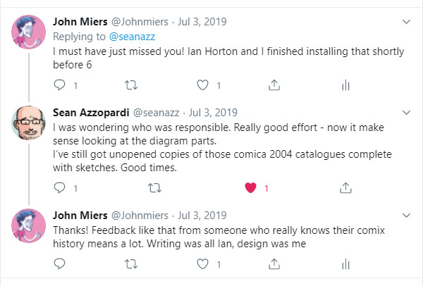

Slide 23
Appraisal is the critical archival task by archivists... As archivists appraise records, they are determining what the future will know about its past: who will have a continuing voice and who will be silenced... Underlying these stereotypes and mythologies was an earnest quest, by archivists and historians alike, for objectivity, for impartiality, for Truth, all extolled as self-defining professional virtues, but alas in reality, all an impossible dream in light of the inescapable subjectivity that any value-creating and value-enforcing activity such as archival appraisal must entail.
T. Cook (2009) ‘Preface’ in J. Ridener From Polders to postmodernism : a concise history of archival theory.

