Slide 1
Collaborative pedagogies: On line learning and classroom talk
Beth Lloyd School of Education, FHSCE
Paul Booth School of Humanities, FASS
Valerie Coultas
School of Education, FHSCE
Notes:
Valerie
Introductions, two presentations, questions for both papers at the end.

Slide 2
Presentations focus on the role of language in learning and the shared construction of knowledge i.e. collaborative teaching and learning
The first presentation looks at how new literacies and on line learning can enhance student engagement. The second presentation focuses on how the more established practice of classroom talk can enhance and deepen learning: but both approaches also place new demands on teachers and students.
Both presentations are a result of joint planning and evaluation by lecturers at KU working on the MA(Education) English Language Teaching and ITE programmes
Notes:
Valerie

Slide 3
From simulated online language learning and teaching to the real world
Beth Lloyd &
Paul Booth
MA ELT Programme
Module: Educational Technologies for English Language Teaching and Learning
Notes:
Beth
Describe MA ELT programme. Students recruited from around the world, both EU and non-EU and some UK home students each year. This is not a teaching qualification bu the programme requires student to consider a variety of pedagogies and practical teaching strategies and their underpinning theory, including practical teaching situations.

Slide 4
Face to face and online communication
Communication pathways
Notes:
Paul
Kingston students:
All studying for a Masters in English Language Teaching;
Half of the students were L1 English;
Some had teaching experience whilst others did not;
French students:
L1 mostly French; most lack confidence in English language ability;
All studying at Université Lumière Lyon 2 for a Masters (2 years) in primary teaching, education and training;
Preparing for a competition in the first year to get into the state school sector: internship, preparation for the national exam (subjects include: psychology, philosophy, sociology of education, curricula), plus research seminars and 60 page dissertation, therefore under pressure;
Most are pre-occupied with the state exam.
The master’s programme includes a compulsory course in English: 21 hour intensive, weekly 2hrs, online with Kingston plus 10hr intensive
All second year Masters students were encouraged to do the online English course with Kingston;
Some first year Masters were coerced to choose the online option; it would be assessed, taken into account as part of their course, improve their English.
M1 student already working in primary/secondary was encouraged to participate in online course despite busy timetable.
The French and English masters students had contact via VLE.

Slide 5
From simulated to authentic teaching and learning
Notes:
Beth
A little background: In previous years of teaching this module we had used what we called ‘simulated workshops’. This meant that students were required to design and facilitate an online workshop for developing English language skills for other students in the class, and also required to become ‘learners’ in the workshops of others. This worked to a degree, and gave the students experience in instructional design for a purpose and teaching in an online environment. However, we kept getting feedback in end of module evaluations that said students really wanted real English language learners and not classmates pretending to be learners, to be undertaking their workshops. So drawing upon elements of Situated Learning Theory (Lave) and Authentic Learning Theory we set about to make the workshops a more authentic teaching and learning experience. Drawing upon a French colleague with whom Paul had previously worked we arranged for a group of French Masters students to be the learners for the workshops.

Slide 6
The online distance workshops
Student workshops
Notes:
Beth
They were required in the first instance to do a needs analysis to find out more about the interests/language level/specific areas of language the French students.
The workshops were to contain a maximum of 3 tasks, involving one hour of learning, to be uploaded onto Studyspace which Lyon students were given access to.

Slide 7
Applying the language of comparison
Notes:
Beth
Each of our 20 Kingston students created an online distance workshop for 2 or 3 French students training to be primary teachers, to facilitate their learning of English who were grouped by English language ability
They had access to a range of technologies and were encouraged to use multimodal teaching tools, including the use of video, image, sound, discussion forums They brought varied technical skill levels to the work so they were not required to create multimedia objects but were encouraged to find and utilise appropriate existing resources including YouTube and other video repositories, Image data bases, games, simulations, games. Some did create their own video or used Skype or social networking technologies to communicate with the French learners but this was not required for a successful workshop – some of the most coherent and successful workshops ones were really rather low tech apart from the use of basic Blackboard/Studyspace features.

Slide 8
Notes:
Beth
This is the opening screen of one of the workshops, showing tasks and overall theme. Her French students had indicated a desire to learn about the language of applying and interviewing for jobs.

Slide 9
Vocabulary of employment
Notes:
Beth
This is the first task in the same workshop, looking at the vocabulary of employment, with links to an online French dictionary for scaffolding the learning.

Slide 10
Writing a letter of application for a job
Notes:
Beth
Same workshop, second task focusing on the grammar of letter writing or job hunting and the appropriate tenses to use to describe work experience and current activities. She has modeled a letter of application for a teaching job

Slide 11
Responding to a job advertisement
Notes:
Beth
Next the French students are given a real job advertisement and asked to write their own letter of application using the model letter to scaffold the activity if necessary.

Slide 12
‘Why should I hire you?’
Notes:
Beth
Finally, the French students are asked to listen to a video of someone in a job interview being answering the inevitable question ‘why should I hire you?’ The French students are asked to watch as many times as they like, identify the positive personality adjectives and then write to the school from the advertisement and write out the answer to this interview question. Note she has not really produced any technically difficult teaching resources but rather has put together existing multimedia elements like video, hyperlinks, image to allow for development of listening, reading and writing skills. It could be argued that it might be better to get learners to do the final task as a spoken activity, recorded, but overall this workshop generally has a coherent progress of learning and appropriate aims for the particular learners.

Slide 13
Use of ‘found’ teaching resources
Notes:
Beth
Some students based their workshop entirely around videos found on YouTube that model particular aspects of language or lend themselves to further exploration and application of the language. This video is about the balance between teaching for the heart and teaching for the mind and the workshop required a group of more advanced French learners to prepare a written and Oral response, via Skype, to the argument put forward in the video.

Slide 14
A range of CMC modes were utilised
Notes:
Beth
The students used a range of CMC strategies, with asynchronous(pre-prepared) and synchronous(via Skype) use of video. This student made a series of videos of herself speaking containing language errors and asked the French students to identify and correct them.
So looking at the workshops overall our students are now working with authentic language learners, doing authentic tasks rather than simulated peer teaching, and using a range of technologies and communication strategies in their teaching. So far so good.

Slide 15
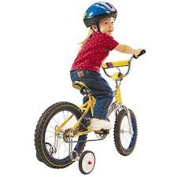
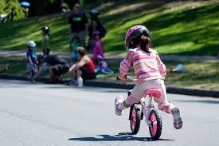
From simulated to situated
Brown, Duguid, Collins (1989)
Notes:
Beth
Challenging the theoretical separation between knowing and doing
Knowledge fundamentally ‘situated’ within the activity, context and culture in which it is developed
Teaching and learning methods chosen accordingly
Teaching through ‘cognitive apprenticeship’

Slide 16
The feedback
Pourriez-vous évaluer les matériaux en ligne et répondre à questions suivantes :
1. L’atelier atteint les objectifs pédagogiques ? Expliquez votre réponse.
Achieves the stated learning objectives?
2. L’atelier faciliter l’apprentissage de la langue anglaise ?
Facilitates second language acquisition ?
3. Les matériaux multimédia sont utilisés efficacement pour aider à améliorer et consolider l’apprentissage de la langue ?
Makes appropriate and effective use of multimedia to support and enhance learning?
4. Les matériaux engagent l’apprenant ?
Engages the learner ?
5. Les matériaux encouragent à répondre profondément plutôt que superficiellement ?
The materials encourage deep cognitive processing of the learner?
Notes:
Paul
Feedback via this questionnaire was obtained from the French learners at the end of the workshops and fed into the Kingston written part of the assignment which was a reflective evaluation of the learning that took place.

Slide 17
Pedagogy: strategies and approaches
Task creation led to the facilitators reflecting on their own teaching skills and approaches:
‘I had to try and resist just transferring the skills that I use in a normal classroom onto the online environment because it wouldn’t exactly work.’
‘But this really made it personal. And it really made you think critically about the way you plan lessons and staging everything’.
Notes:
Paul
The Kingston student had to change their teaching strategies. So there was a shift in their schemata for face to face teaching to online facilitating. What they had done in the past might not be appropriate for what they had to do online. As they highlighted, it made some of them more critical and analytical in their planning.

Slide 18
Pedagogy: student engagement
Actual learners meant that there was a lot at stake. How would our students ensure the Lyon students would engage each week?
Heavy reliance was made on the needs analysis to keep the tasks relevant to students’ needs and wants.
‘Because we were uploading these tasks on a weekly basis, how am I keeping them, what am I doing to make them come back next week? So variety is very important I’ve learnt’.
Notes:
Paul
Student engagement was a problem because some of the Lyon students (i.e. the ones already in work/preparing for internships) had busy schedules and were perhaps coerced into doing this online course. Our students thought that trying to find out their needs and wants would mitigate against this. Whereas in the feedback from France more two-way contact was wanted e.g. our students give more information about themselves to give the Lyon students a sense of who is at the other end. Some Kingston students put the onus on us as to how to keep the Lyon students engaged and motivated to do the tasks.

Slide 19
Pedagogy: complexity
The price to pay for greater complexity was greater demands placed on Kingston students.
Students with experience might have felt less pressure than those with little or no experience.
‘…people that have never taught before, not only are they learning to do online teaching, they have to teach online, they have never seen their students, they have to plan their lesson properly, using technology which they are not possibly familiar with, they have to take the technological factors into it …’
Notes:
Paul
This complexity gave rise to some peer-supported learning outside of class. Some of the Kingston students were not comfortable with problem solving for themselves. Students asked us for help and tips which we gave. However we also gave different answers to their questions to which our students wanted the ‘right’ answer.

Slide 20
Communication: expectations
Lyon students wanted more real communication to gain confidence in using L2 English.
“J’ai passé beaucoup de temps à répondre à ce qui était demandé et j’ai juste eu comme retour une bonne appréciation alors que je sais qu’il y a des fautes, ou des tournures trop françaises”.
I put in a lot of time to respond to what was asked of me and I just had in return a positive reply. However, I know there were mistakes or turn of phrases too French.
Notes:
Paul
Encouraging not only the Lyon students but also the Kingston students to present themselves is an important step to add. It would not only encourage more engagement but also contribute to forming a bond between the Kingston and Lyon students. Improving the way Kingston and Lyon students are engaged is essential. Otherwise although many French students were very enthusiastic about their English tutors, some of them had the feeling that they were not well assessed.

Slide 21
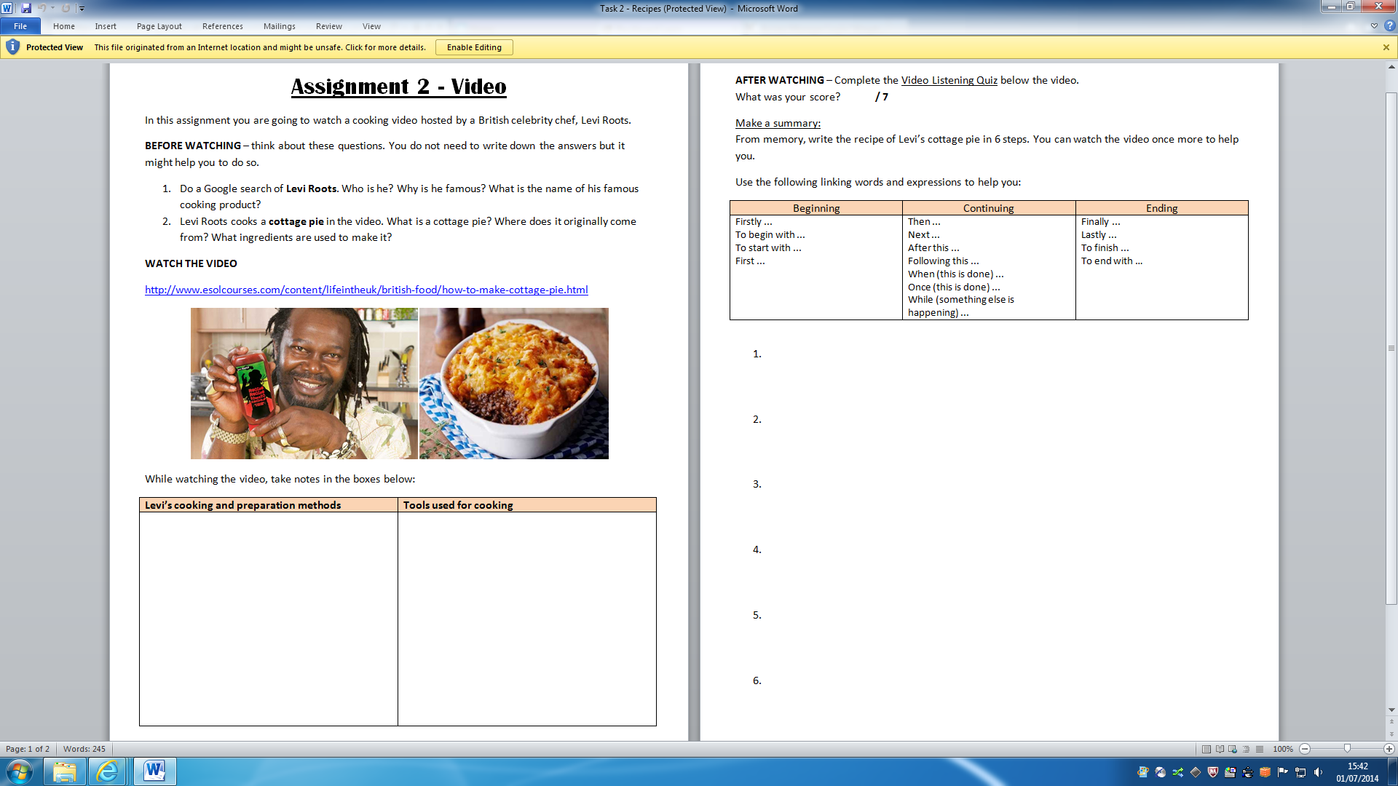
Pedagogy: materials design and teacher development
‘…and I think even creating the materials it helped me improve my skills as a teacher cause not only the pedagogical side to it… but I feel like that really helped me to think of different ways.. to think how to use a simple thing like movie and base my lesson on that or at least make it the beginning of the lesson. So I think it pushed me as a teacher and there was pressure but I feel like it helped me develop as a teacher.’
Notes:
Paul
Tomlinson (2013: 482) argues that in order to cater for the wants and needs of their particular learners, teachers need to be able to select, adapt and supplement materials, and to do this effectively they need to be helped to develop the awareness and skills required for successful materials development. In the process of developing awareness and skills, teachers can also develop the ability to theorize their practice. This student has now obtain a job with CUP working with material writers. Anecdote of weather materials.

Slide 22
Expectations
‘I think perhaps if they know how much this is worth perhaps 5% or 10% whatever is given and maybe, I actually read about the French education system where there is this focus on product and not process; there is the focus on the teacher, teacher centred way and not student centred and so I think that maybe adds to…that caused more problems for me because with the student, because maybe she didn’t consider this a way of learning language’ (Kingston student)
‘It felt sometimes as if my learners didn’t quite know what the whole thing was about and they were incredibly excited and motivated to learn English but they didn’t understand that this was just an experiment, or not an experiment, but that this was just a limited task they had to do and its not going to be an ongoing thing, its not going to be life changing for them (laughs).’(Kingston student)
‘One of the learners didn’t manage to complete all the tasks, I think partly because the technology didn’t work but also I think also they just weren’t really aware of what was expected of them. Maybe that’s partly my fault because I didn’t explain in detail enough at the beginning, you know, this is the time you have to do it. You know I did say it, but maybe I should have said it earlier’ (Kingston student)
Notes:
Paul
It was also clear from much of the feedback from the Kingston and the French students that expectations regarding the role of each group of participants were needed to be made clear from the outset.

Slide 23
The feedback: the good, the bad and the ugly
2. L’atelier faciliter l’apprentissage de la langue anglaise ? Facilitates second language acquisition ?
S1 : It does but it’s important to get informations about our tutor at the very beginning of the session – it helps to get involved.
S2 : Yes I learn some new vocabulary.
S3 : If this online workshop is considered as a language support class or maintenance of level, especially for student in university who are not doing their studying in English language but need this language to do some academic activities or for salaries who want to improve their English skill for a professional objective, the idea of a English class online seems quite realistic and useful.
Notes:
Paul
Stronger Kingston students tended to get more positive feedback.

Slide 24
The feedback: the good, the bad and the ugly
2. L’atelier faciliter l’apprentissage de la langue anglaise ? Facilitates second language acquisition ?
S4: Je pensais que cet atelier aurai pu me facilité l’apprentissage de la langue anglaise mais ce ne fut pas le cas. I thought this workshop will have been able to ease the learning of the English language, but this was not the case.
Notes:
Paul
Interestingly the weaker Kingston students had worse feedback. Weaker in the sense of lack of engagement with the course.

Slide 25
Autonomy and Powerlessness
The more autonomous teachers reflected on what they could have done differently and believed in their own efficacy.
The less autonomous reflected on limitations of the technology or failings of the French students and felt largely powerless to affect change in the learning environment
Link between autonomy as learners and independence as teachers
Digital Natives/Digital immigrants (Prensky, 2001)
Notes:
Beth
We noticed that certain students were able to act largely independently in their teaching of the workshops while others were very dependent on us throughout the facilitation process. Those who struggled as facilitators in the workshop tended to be the ones who were least autonomous in their own learning, thus perhaps becoming autonomous teachers. Feedback from the more autonomous ones reflected on what they could have done differently in the workshop to improve the communication and learning whereas the less autonomous tended to highlight limitations of the technology or the failings of the French learners rather than their own practice, feeling powerless to affect change in this teaching environment. This link between autonomy as learners and independence as teachers needs further unpicking and in the future we want to focus on ways of increasing this. Also related to resilience.
This is of coures is a complex thing we have asked them to do in this module and requires skill in teaching as well as a certain level of technical ability. This was somewhat risky and could have gone very wrong because we had no leverage on the French students little power to make the communication work. The only leverage we could possibly have is some sort of grade or mark given to the French students involved.

Slide 26
Conclusions & implications
Kingston students tended not to realise the implications of facilitating actual online learning until during or after the event.
The pressure of materials preparation for authentic online learners saw a developing awareness of the complexities involved.
Some Kingston and Lyon students had a lack of engagement with the course which led to frustration on both sides.
Notes:
Paul
They thought it was beyond their remit to explain and justify their tasks.
Kingston students were out of their comfort zone. Some helped each other outside the classes.
We had no leverage on the Lyon students to participate which some of our students found hard to accept. Some of our students could not manage/engage their students.

Slide 27
Ways forward
Expectations made more explicit in early stages
Recruit only those French students who have the motivation and time to engage with online language learning materials.
Model needs analysis – strengths and weaknesses
Kingston students ‘present’ themselves via video to avoid communicating into a void.
More exploration of ways to solve problems that arise in the online workshops
Notes:
Paul

Slide 28
References
Boulton, A. & Booth, P. (2001) ‘Communication in the void and communication avoided: Medium and mediation in on-line language teaching’. ASp La Revue du GERAS (Groupe d’Etude et de Recherche en Anglais de Spécialité) 31/33, 2001.
Imms, W. & Lloyd, E. (2001) The ArTeach project: one strategy for integrating ICT skills and curriculum design during pre-service teacher training, in ICT in Teacher Education: Challenging prospects (2001) Chaib, M. & Svensson, A K (eds).
Korthagen, F. A. J. (2010) Situated learning theory and the pedagogy of teacher education: Towards an integrated view of teacher behaviour and teacher learning. Teaching and Teacher Education, 26: 98-106.

