Slide 1
Setting and Marking Poster Assignments to Promote Student-Tutor Engagement
1. Background & motivation
2. Approach adopted
3. Findings
4. Discussion
Dr James Denholm-Price
and
Dr Peter Soan
School of Mathematics

Slide 2
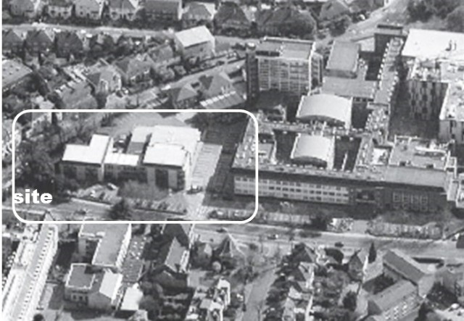
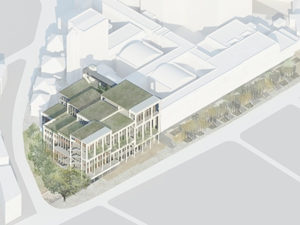
Setting the Scene
There’s a lot of change underway at Kingston
Building programmes
Rationalised courses
Revised Academic Framework:
  30 credit modules
  enhanced support – strengthened Personal Tutor system
  greater emphasis on employability

Slide 3
Group Poster Presentation
Early in Year 1 – Worth 20% of Module
  Task set Week 3
  Presented Week 8
  Each group from one Personal Tutor
  Modal group size 3

Slide 4
Group Poster Presentation
Support
  Discussion with Personal Tutor (who provided topic)
  Workshops – groupwork, research skills, ethics and professionalism

Slide 5
Objectives
Develop students’ skills
Gently introduce assessment at university – ease transition from school
Enhance interaction with Personal Tutor
Initiate tutor-based Study Groups

Slide 6
Sample Topics
Omar Khayyam – Roots of Cubic Equations
Edward Lorenz – The Butterfly Effect
Georg Cantor – Different Sizes of Infinity
Frank Yates – Design of Experiments

Slide 7
Presentation
Single large room – 4 hour session
Light refreshments
A1 poster displayed
Elevator Pitch presentation by students + question/answer
Most Personal Tutors visited

Slide 8
Assessment
Detailed pre-published criteria (approximately 50% content, 50% presentation)
2 staff marking different posters
5% of total mark available via peer review (ranking)

Slide 9
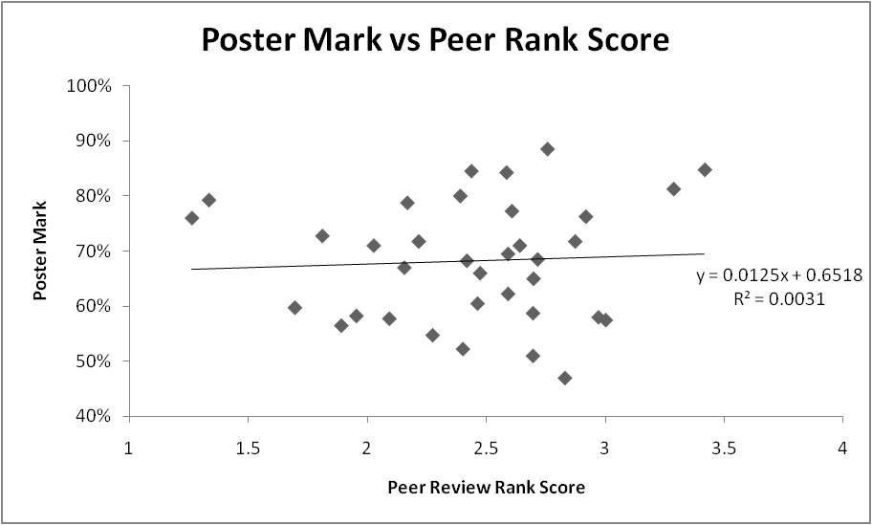
Peer Assessment

Slide 10
Challenges
Groups took time to assemble and ‘gel’
Consistency of level of Mathematics
Marker fatigue during Presentation
Consistency of Marking

Slide 11
Overall Outcomes
High level of student engagement
Virtually all attended for presentation
High standard overall – considerable effort shown in many cases

Slide 12
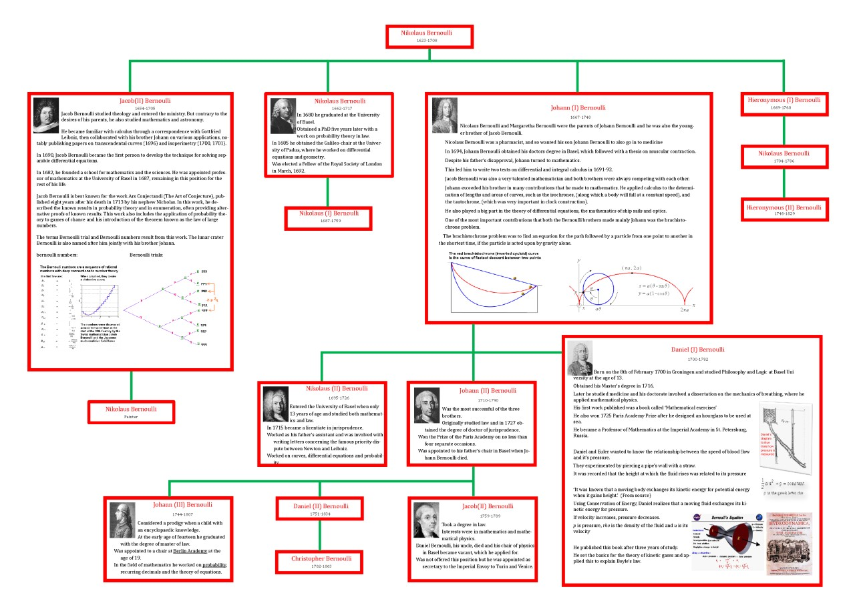

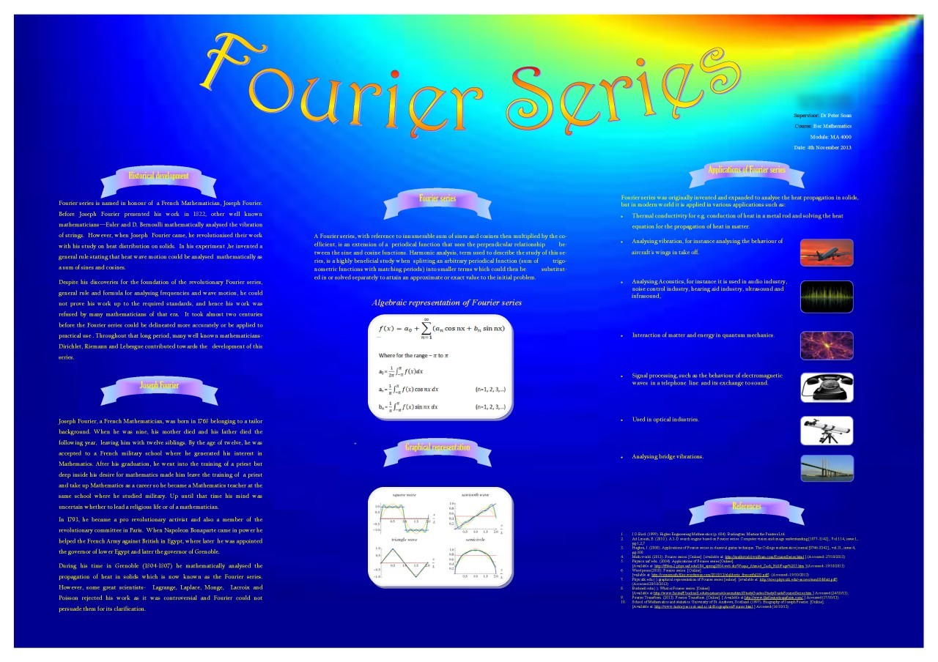
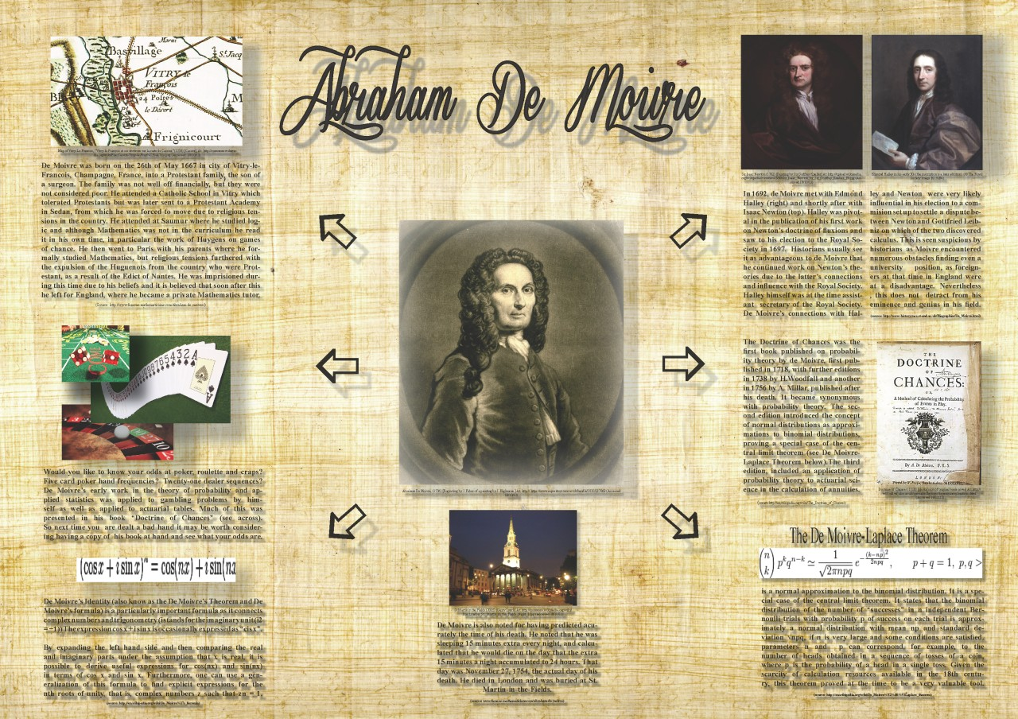
Innovative Eye-Catching Designs

Slide 13
Originality
WikipEasier
than in-depth research
(but not over abused).

Slide 14
Mathematical Content Light
  Some
  but not all

Slide 15
Student Enjoyment
  80%

Slide 16
Longer Term Effects
  60%

Slide 17
Group Durability
  Still together
  25% occasionally
  5%
  regularly

Slide 18
Conclusions
Demonstrated development of communication skills
Successfully motivated students to work early in their course
Some contact with Personal Tutors
Failed to facilitate study group formation

Slide 19
Next Steps
Involve Tutor Groups in preparatory workshops
Use Tutor Groups in follow up activities
Discuss drafts with Personal Tutors
Personal Tutors sole distributors of marks and feedback

Slide 20

Thank You!
Any questions
Notes:
20

